Slide 1
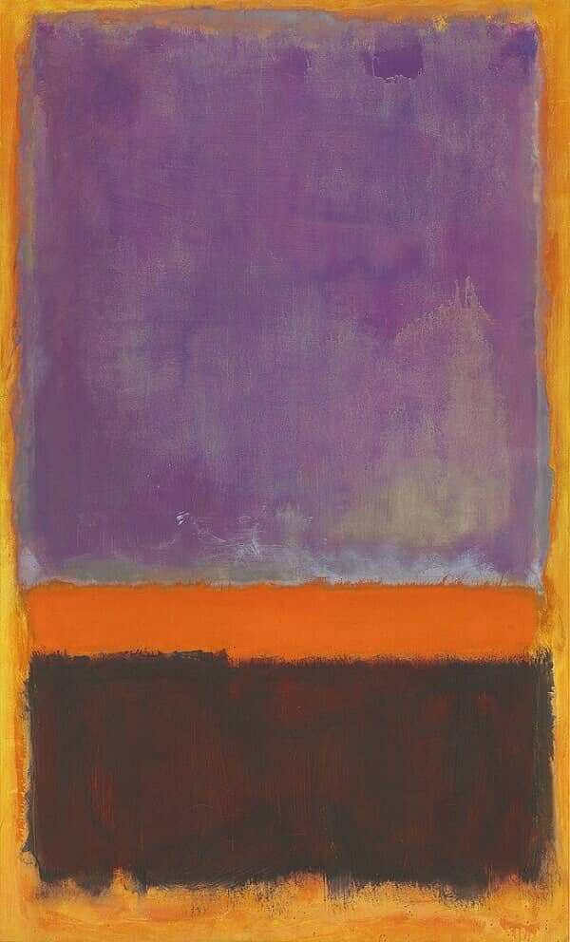


Roaring Rothko
An AAYF Project
by artist
Robin Jack Sarner
November 2025

Slide 2
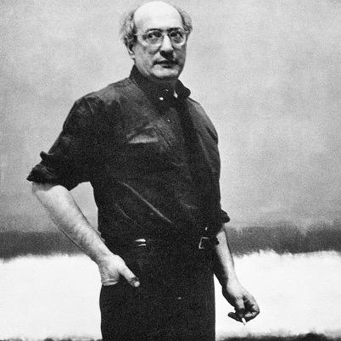
Marcus Yakovlevich Rothkowitz, “Rothko” lived between September 25, 1903 – February 25, 1970) and was an American painter of Russian descent.

Slide 3
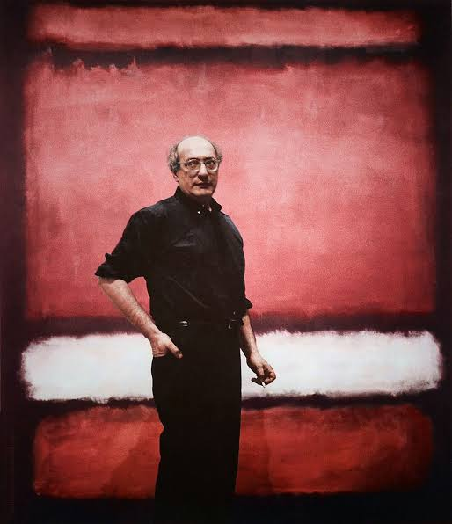
Mark Rothko
Rothko immigrated to the US in 1913, attended Yale for engineering and law, but later moved to New York in pursuit of art in 1923. He became a central figure within a group of abstract artists that changed American art in the 20th century.
Notes:
Born Marcus Rothkowitz in Russia (1903), emigrated to the U.S. in 1913.
Faced anti-Semitism, poverty, and cultural displacement—shaped his worldview.
Dropped out of Yale, gravitated toward philosophy, mythology, and radical ideas.
Maintained a lifelong commitment to artist autonomy and anti-commercialism.

Slide 4
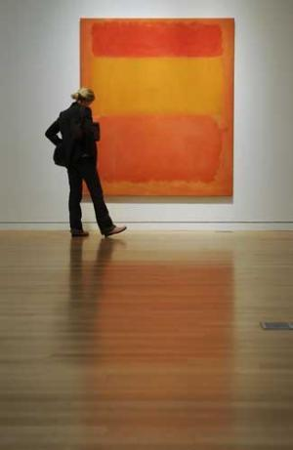
In the midst of the early 1950s and the Abstract Expressionist movement, Mark Rothko began creating his famous color field paintings. Abstract art was a new trend where the artist communicated feelings and emotions using colors and minimal, non- pictorial forms.
Notes:
Why This Project Matters
Inspired by Mark Rothko’s fearless self-expression and emotional intensity.
Advocates for free expression in children, often lost in today's structured, tech-heavy environment.
Encourages abstract thinking and validates the emotional experience through art.

Slide 5
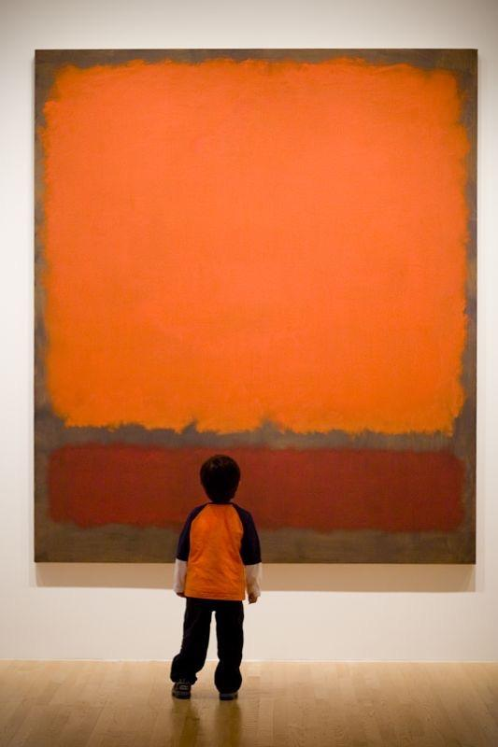
Rather than using realistic images, Rothko gives the viewer the opportunity to create their own imagery of feeling and emotion. Some feelings created are related to the colors themselves.
Notes:
Signature Style
Developed his iconic soft-edged rectangles on fields of luminous color in the 1950s.
Influences: Greek myths, Nietzsche, his Jewish heritage.
Believed color could express universal human emotions—grief, ecstasy, transcendence.

Slide 6
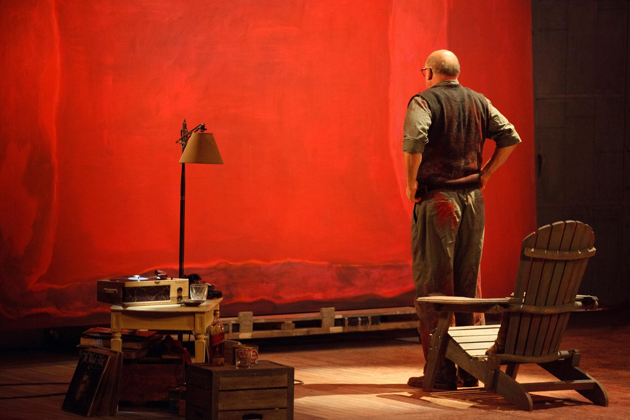
His work is celebrated for its emotional power and its exploration of profound human experience. Rothko is considered one of the most important figures of 20th century art.
Notes:
Student Learning Objectives
Understand Abstract Expressionism and Rothko’s role in it.
Learn color theory, emotional impact of color, and composition.
Create expressive art using chalk and oil, blending colors to convey emotion.
Encourage free exploration and emotional self-expression through art.
Abstract Expressionism – emotion-driven art without clear subject matter.
Color Field – focus on broad areas of color, de-emphasizing form.
Emotional Response, Self-Expression, Organic Shapes, Composition, Surrealism, Color Theory.

Slide 7
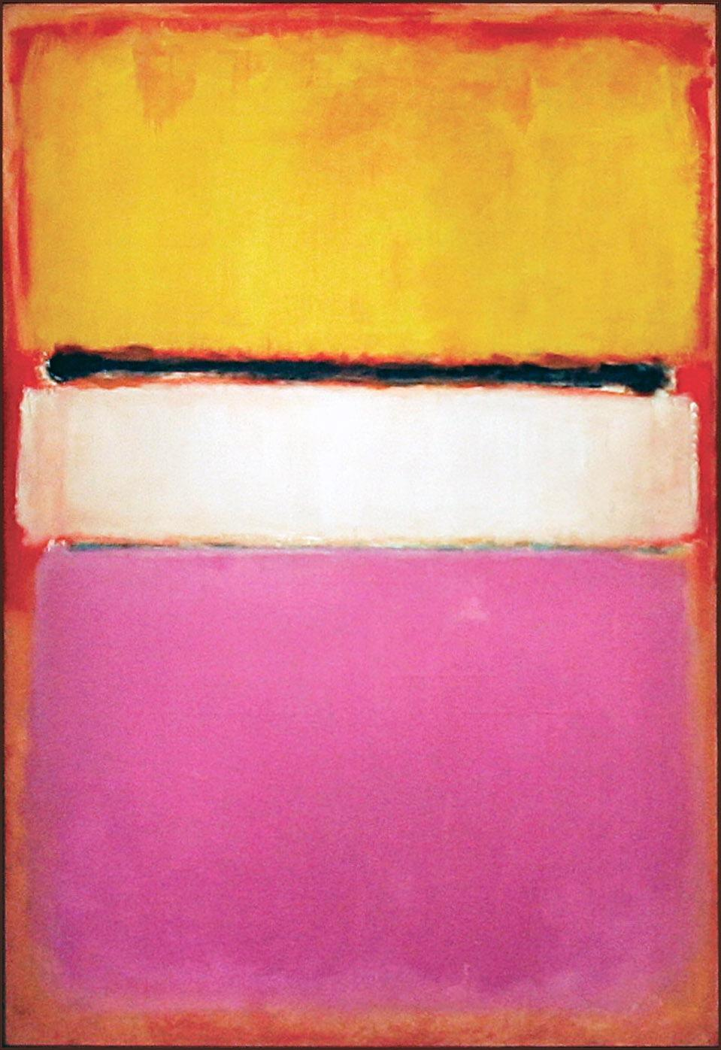
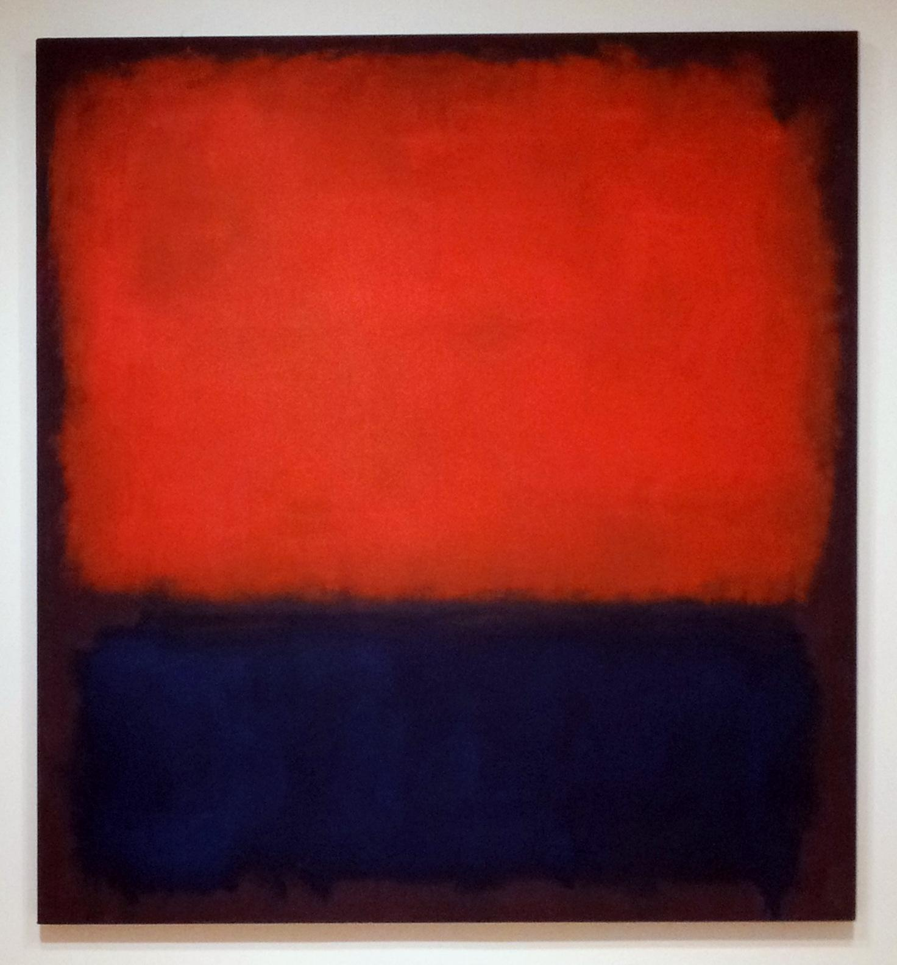
Our project was inspired by these two Rothko’s paintings!

Slide 8
First, position the paper vertically and tape off the edges. Next, make a dividing line horizontally by placing one piece of tape across the page to create two rectangles.

Slide 9
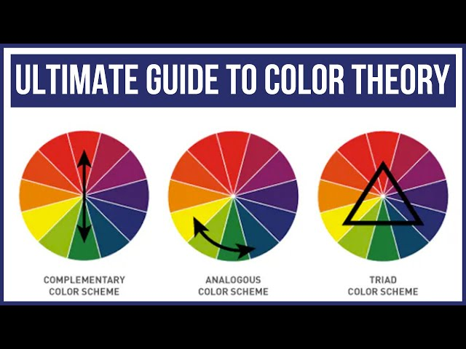
Your top rectangle will have two Analogous Colors and the bottom rectangle will have two Analogous colors that compliment the top colors
Color Theory

Slide 10
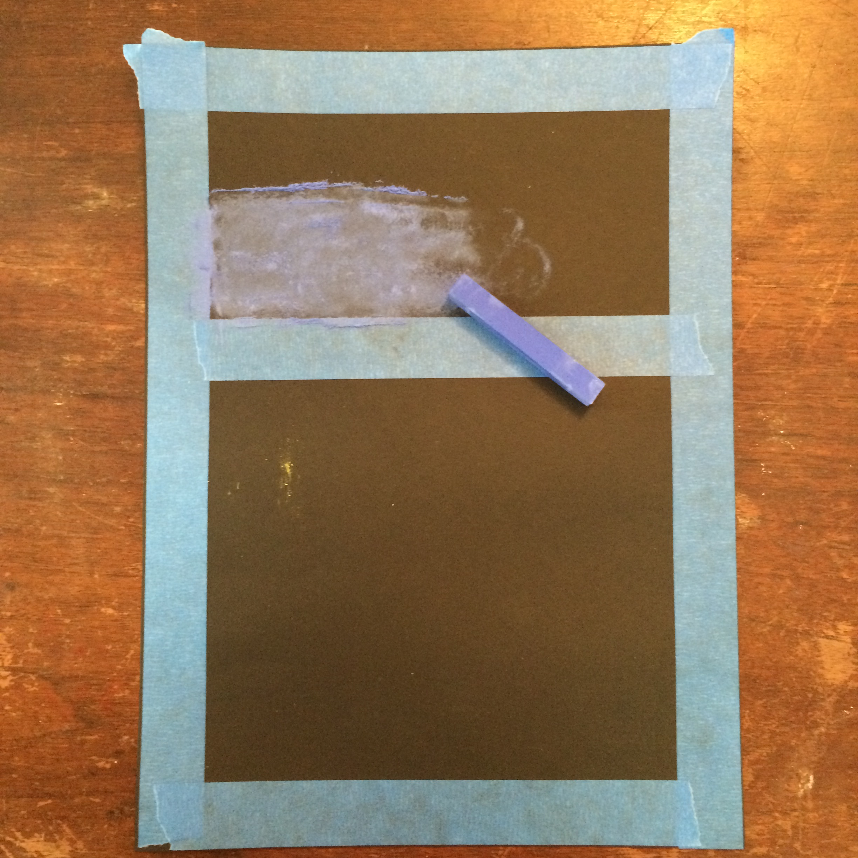
Choose your first color!
Colors and Emotion
Cool: Blue, Green, Purple — calm or sad.
Warm: Red, Yellow, Orange — passion, anger, caution.

Slide 11
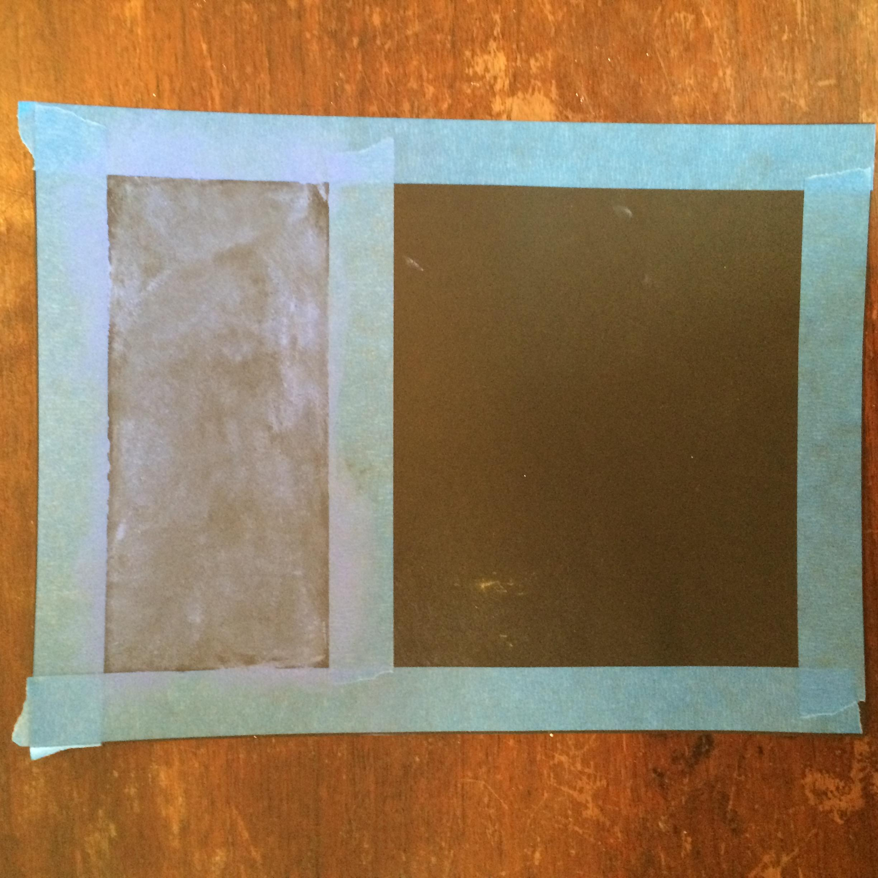
Color the top half completely with the SIDE of the chalk.

Slide 12
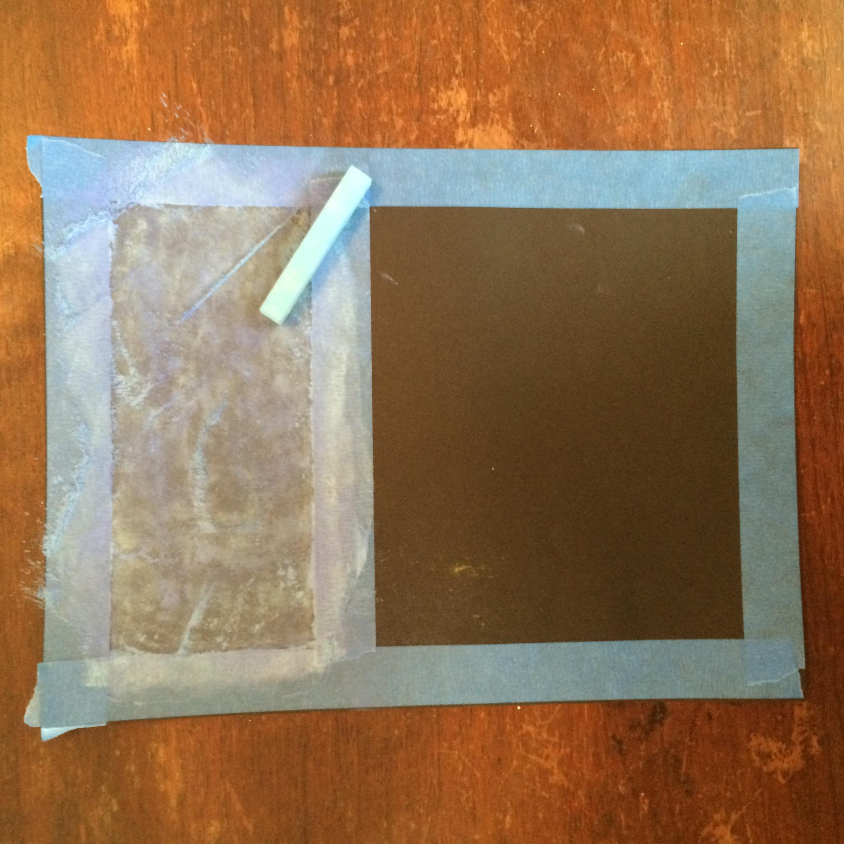
Smudge the first layer, then add a second, complimentary color (next to or same side of the color wheel)
Concentrate only on the top portion.

Slide 13
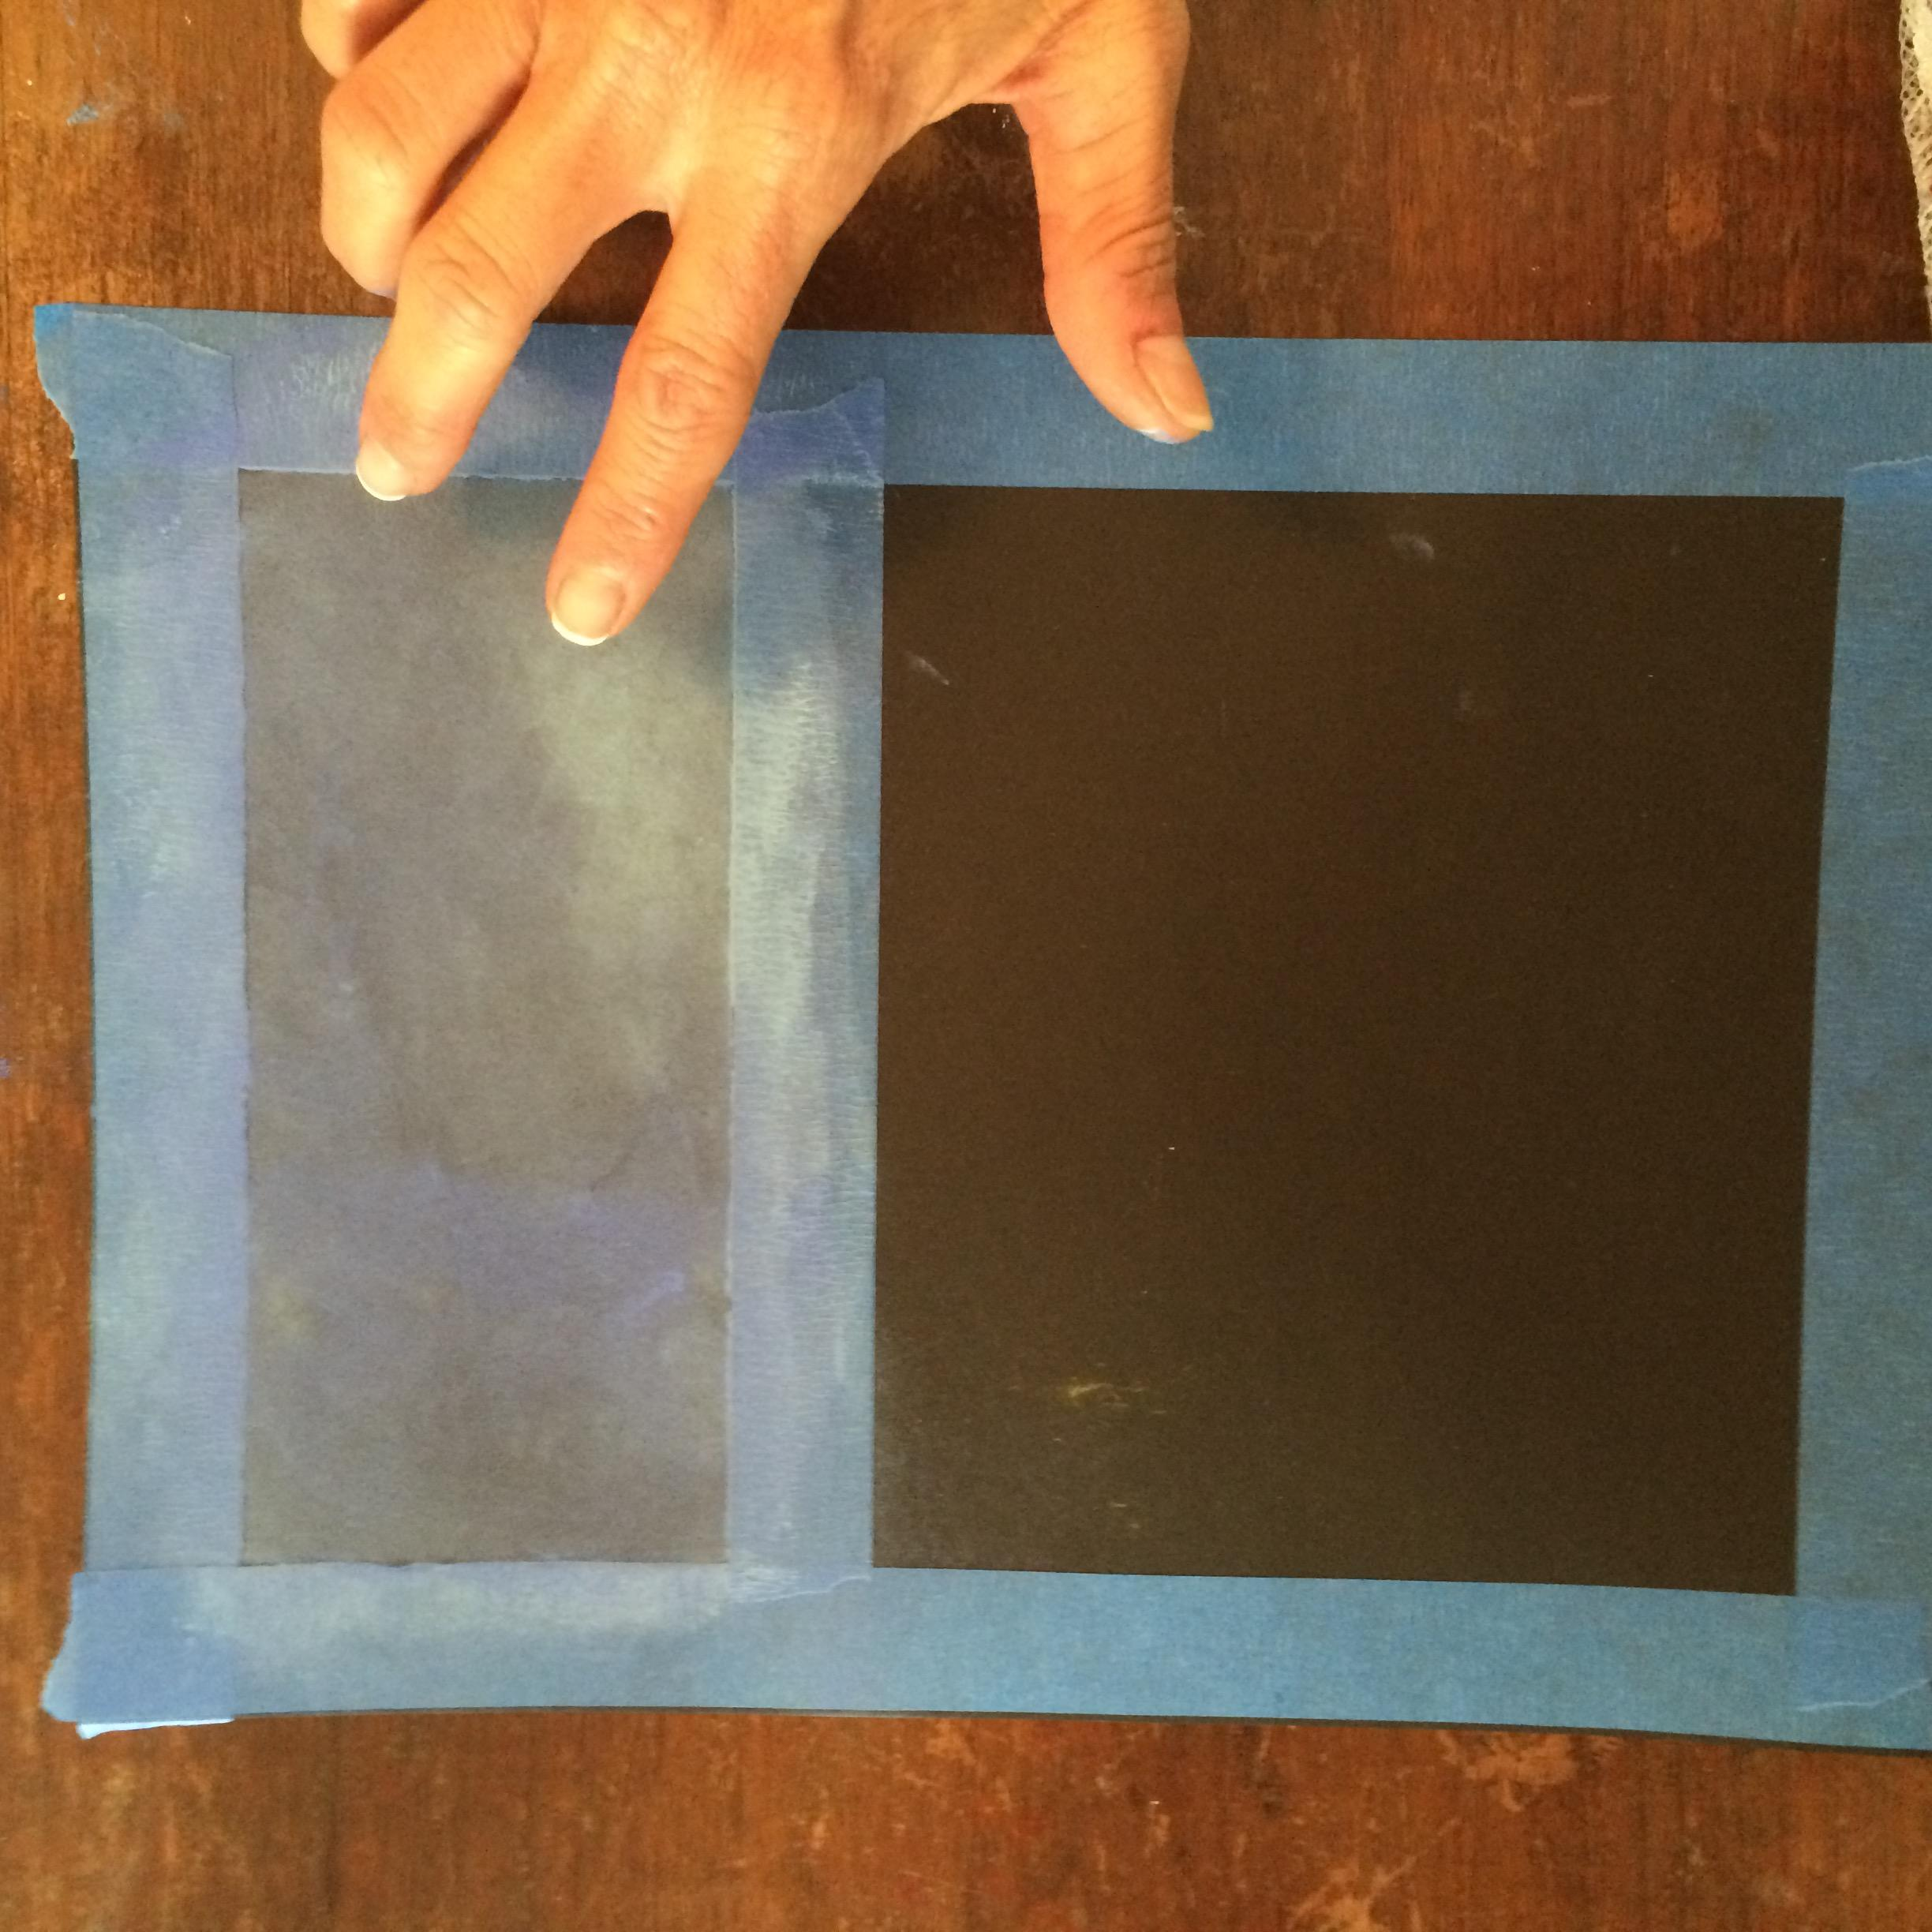
Smudge the two colors together.
Gently tap your paper to clear the dust left behind. Never blow the dust off the paper.

Slide 14
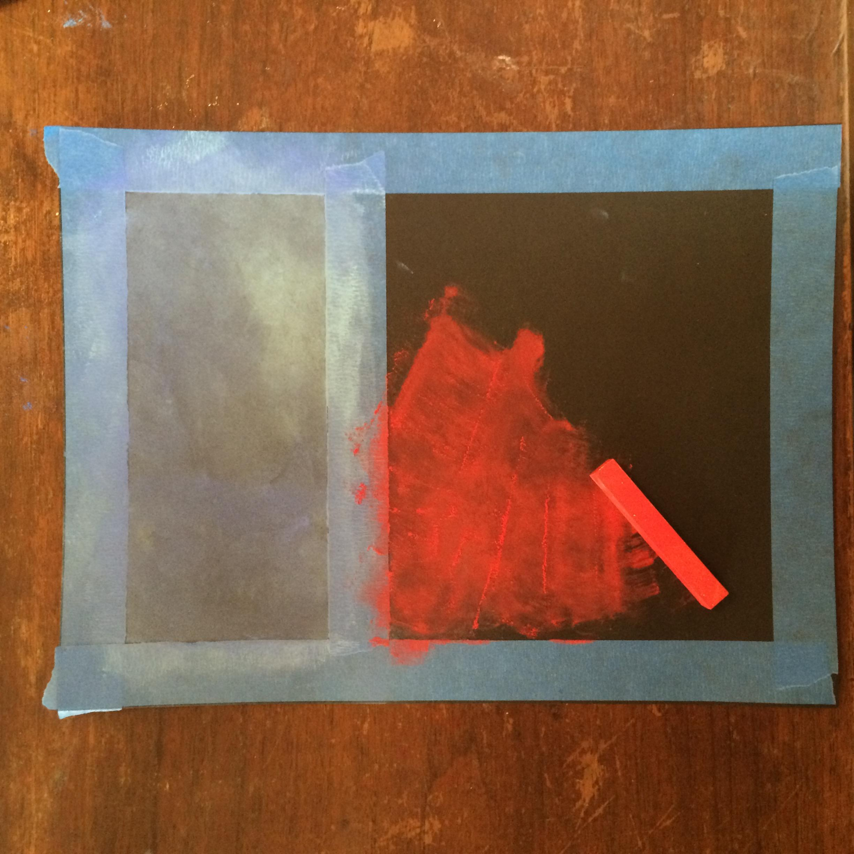
Choose an opposite color from the color wheel for the bottom half and smudge completely.

Slide 15
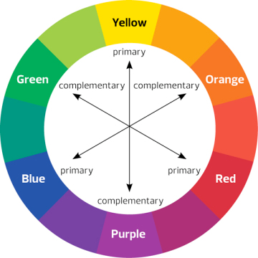

Slide 16
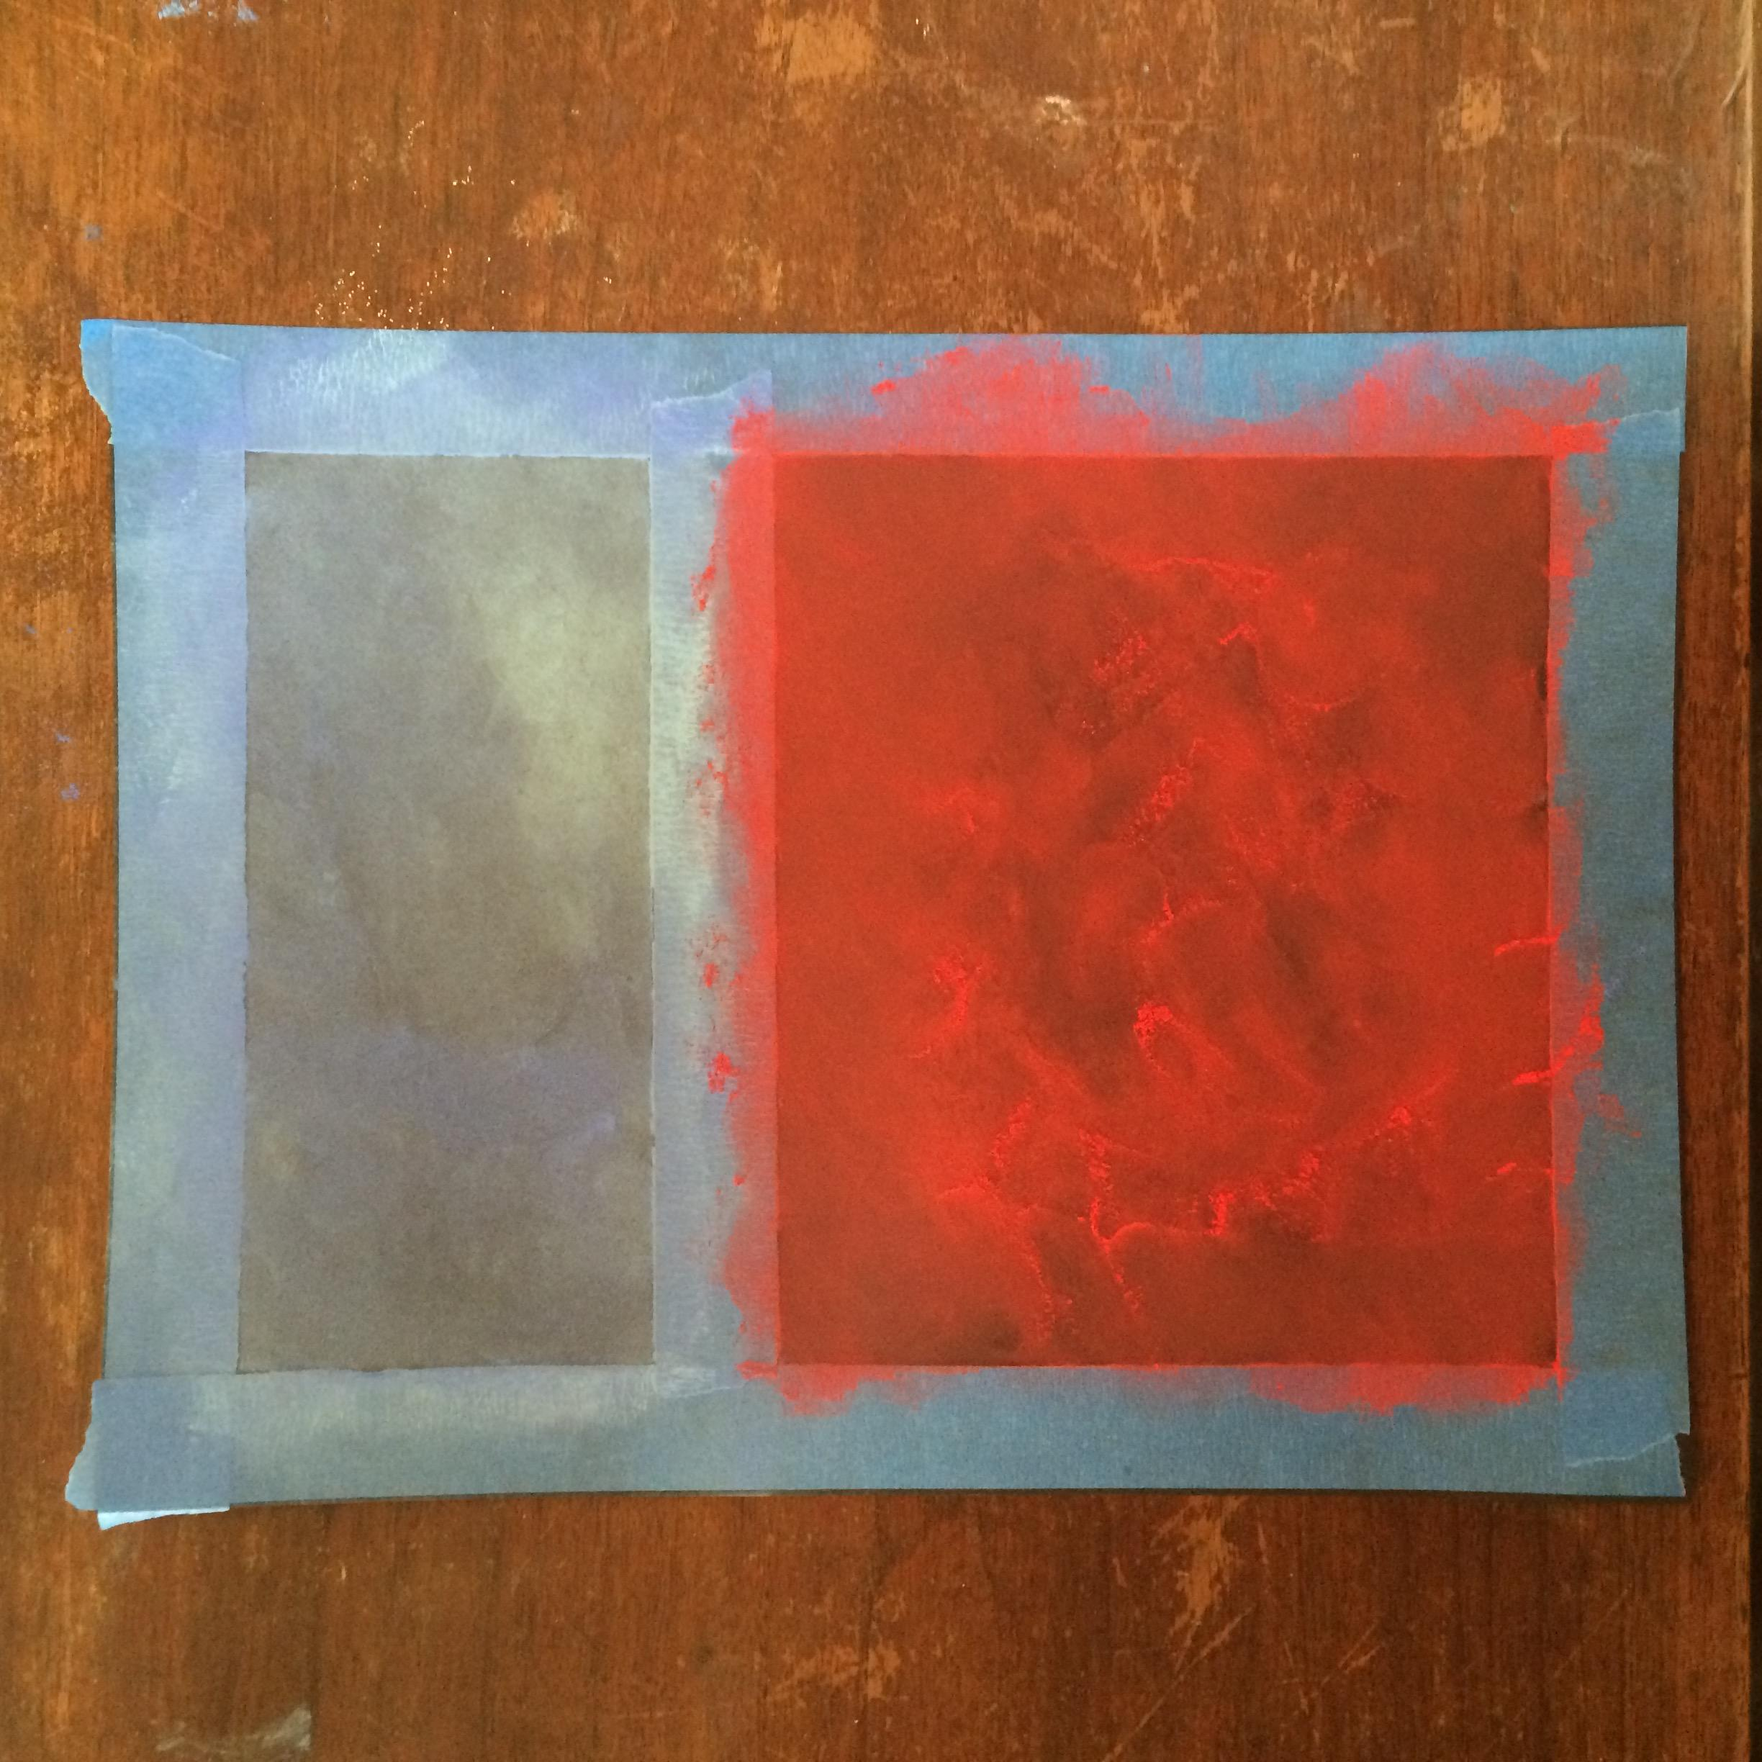

Slide 17
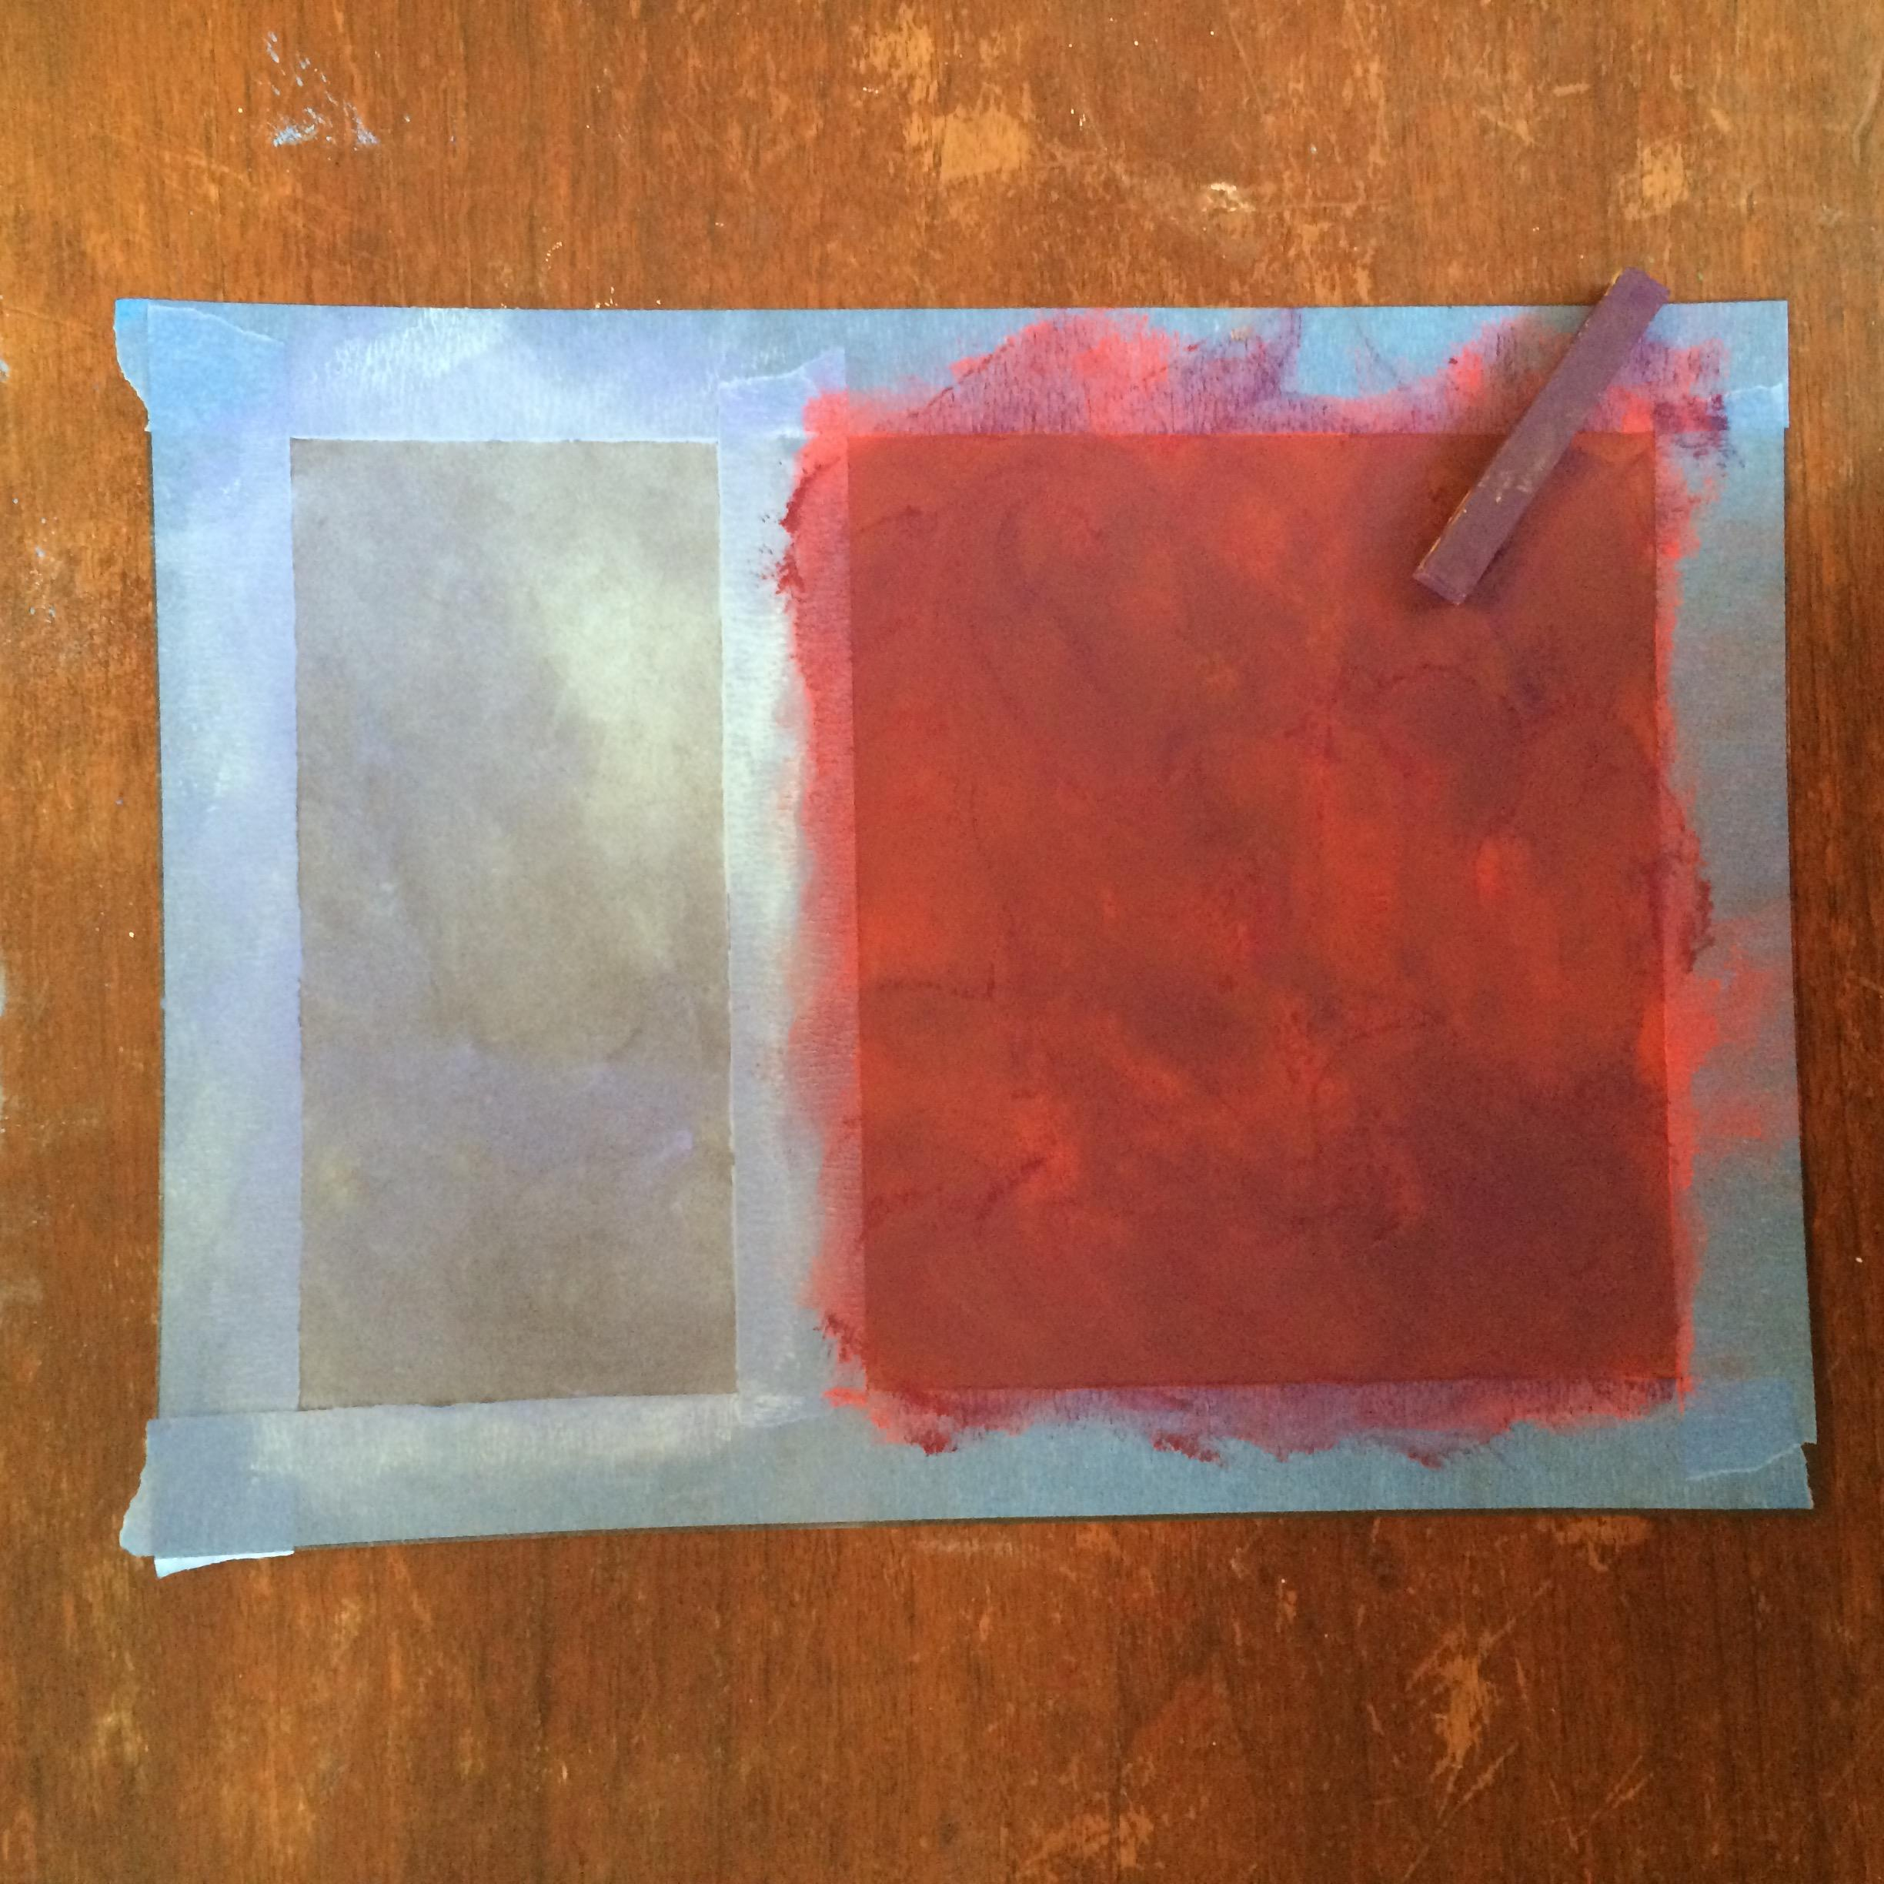
Next, choose a complementary color to layer over the existing bottom half color and smudge!

Slide 18
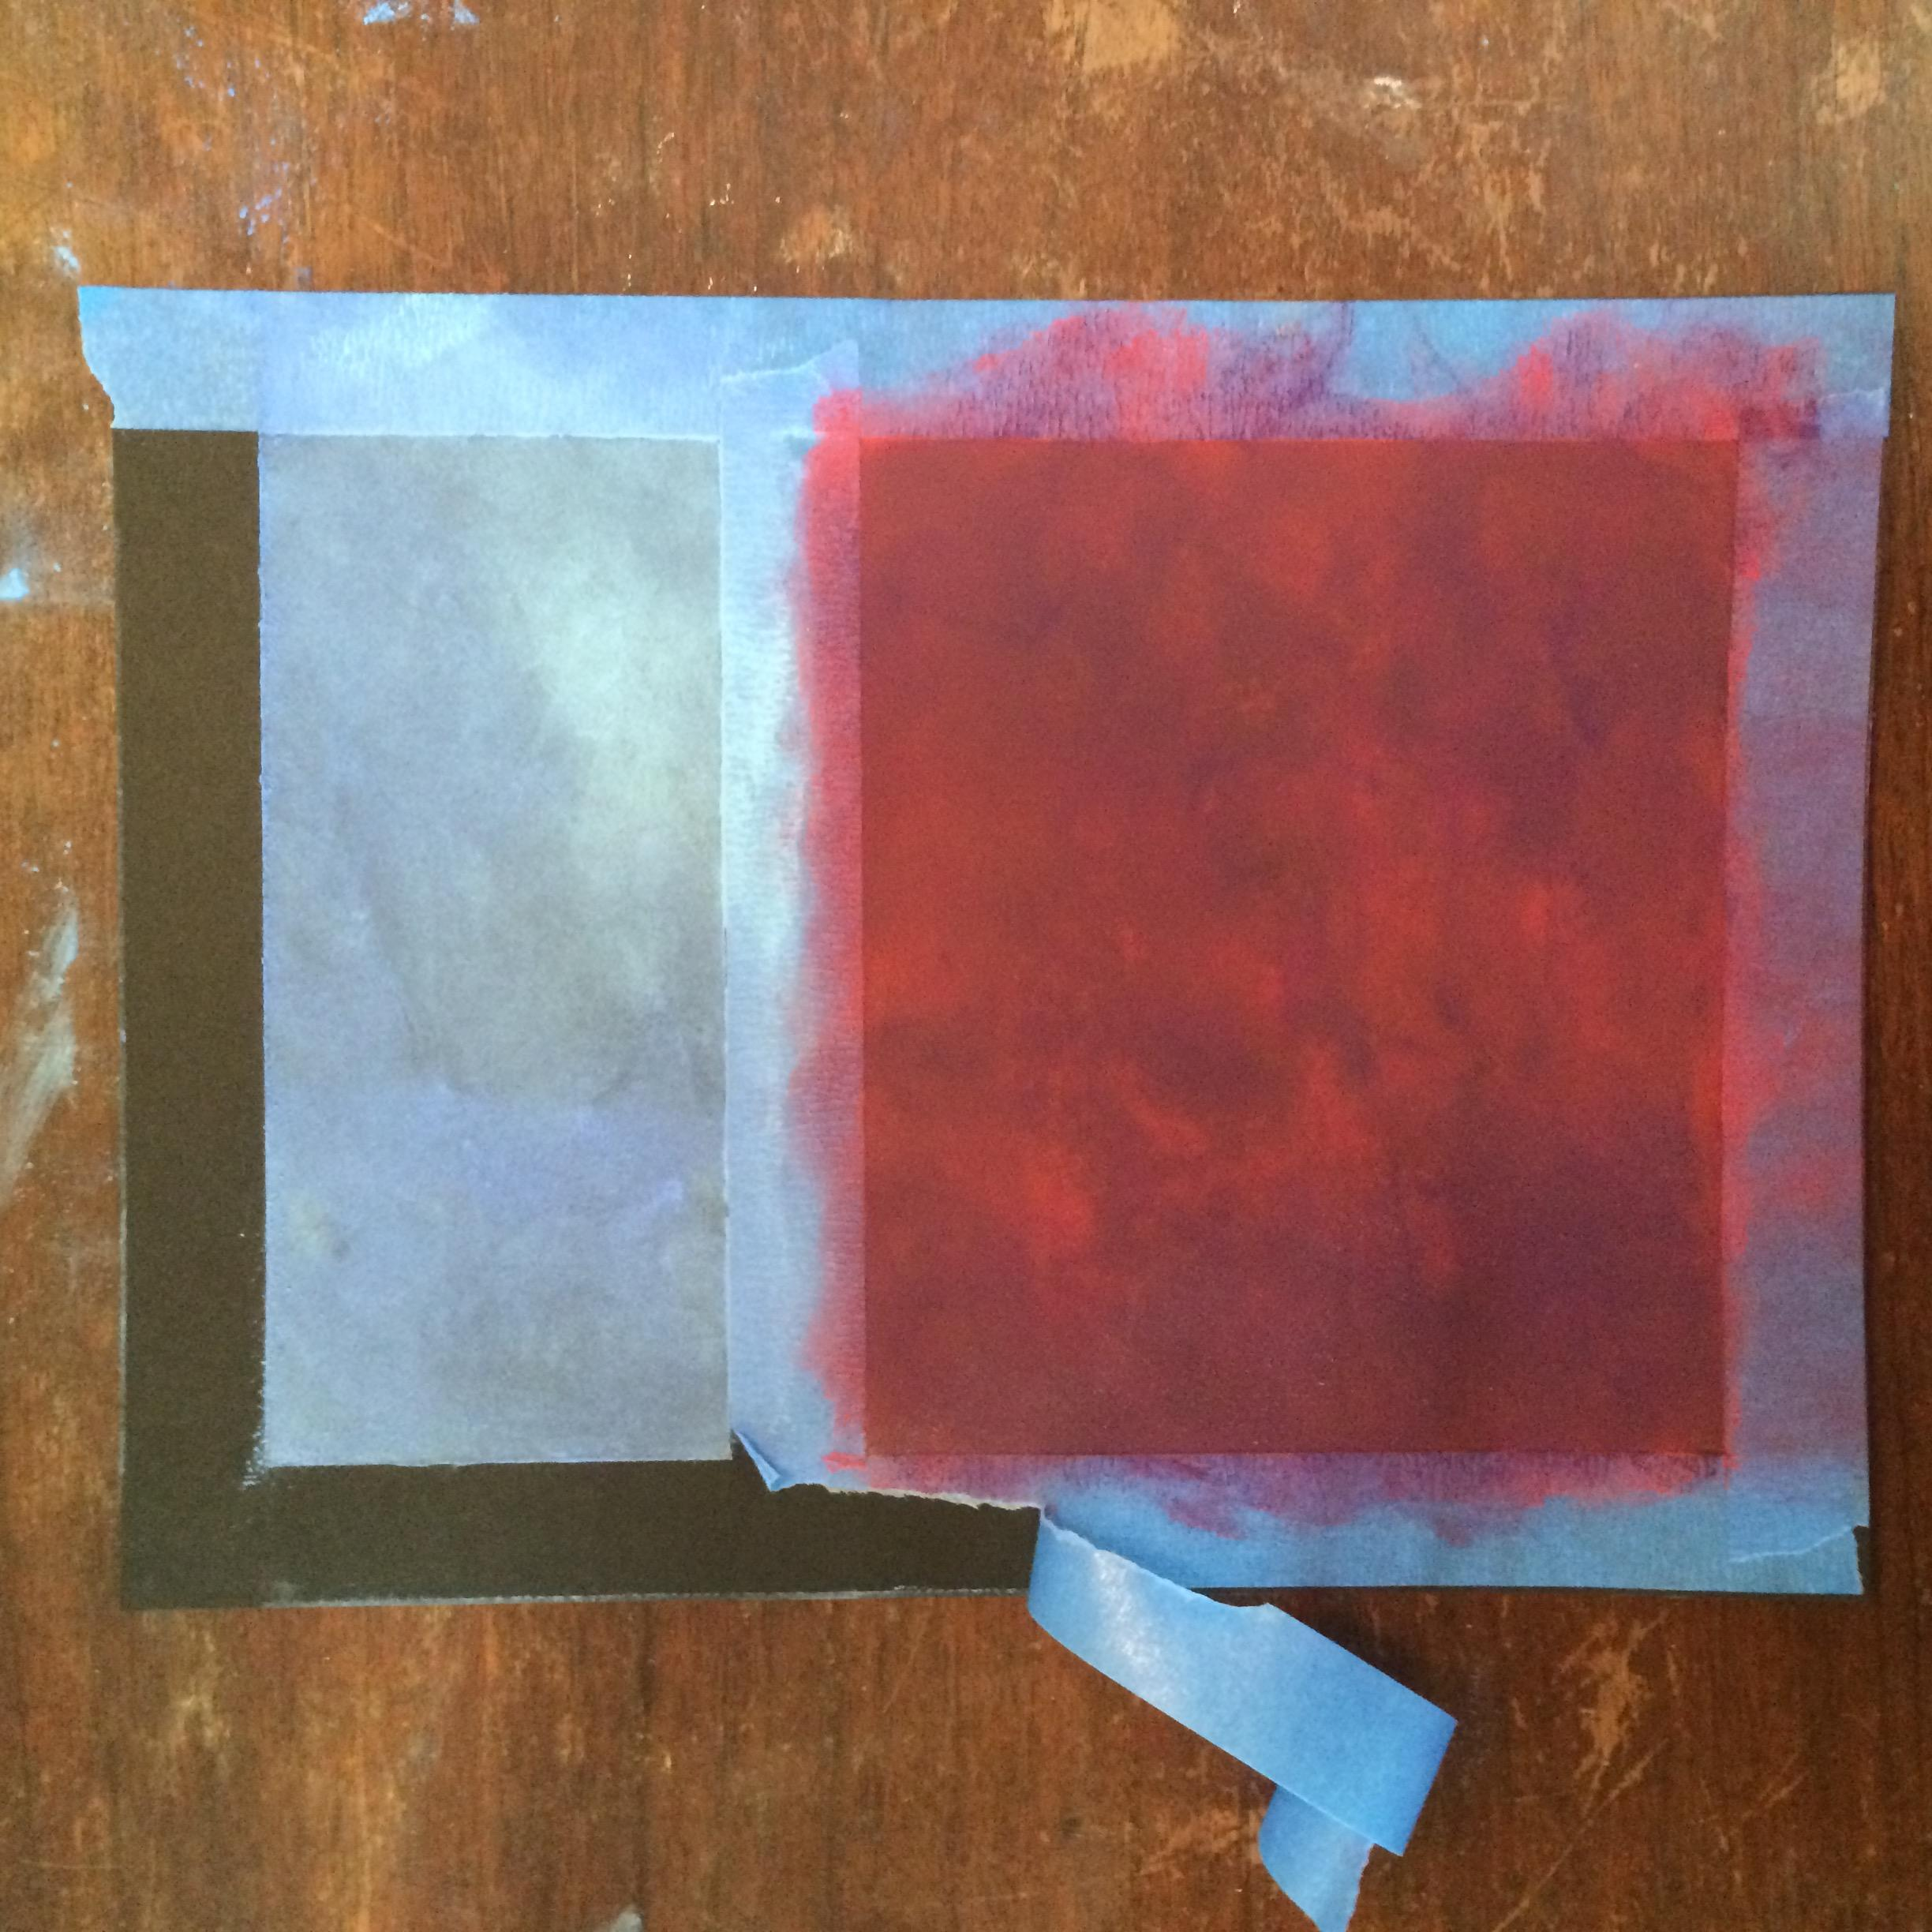
First wipe Hands well.
Then carefully (and slowly) remove the blue tape.

Slide 19
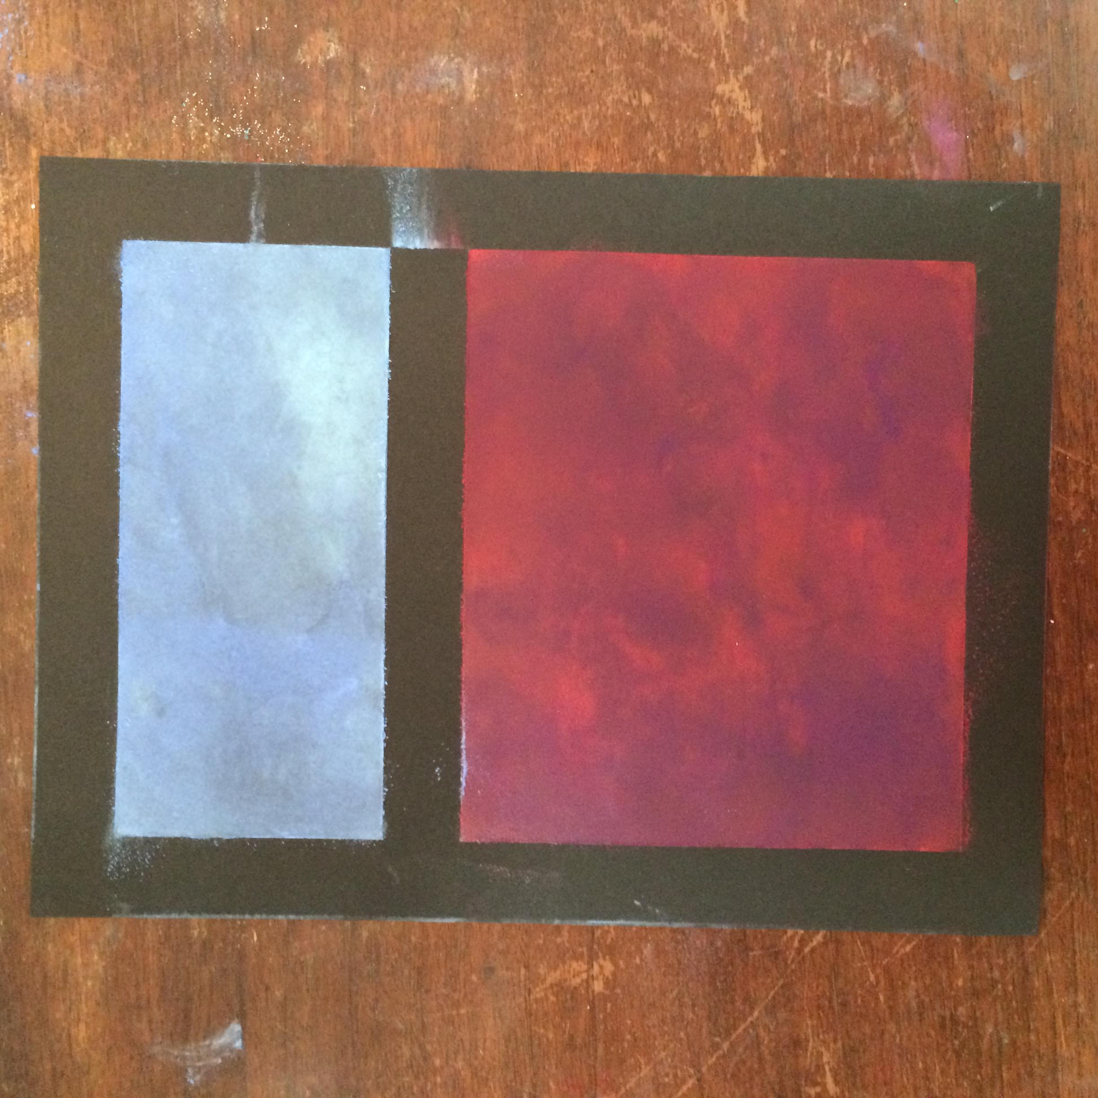
With a damp paper towel, clean up/wipe down the edges without smudging the interior color blocks.

Slide 20
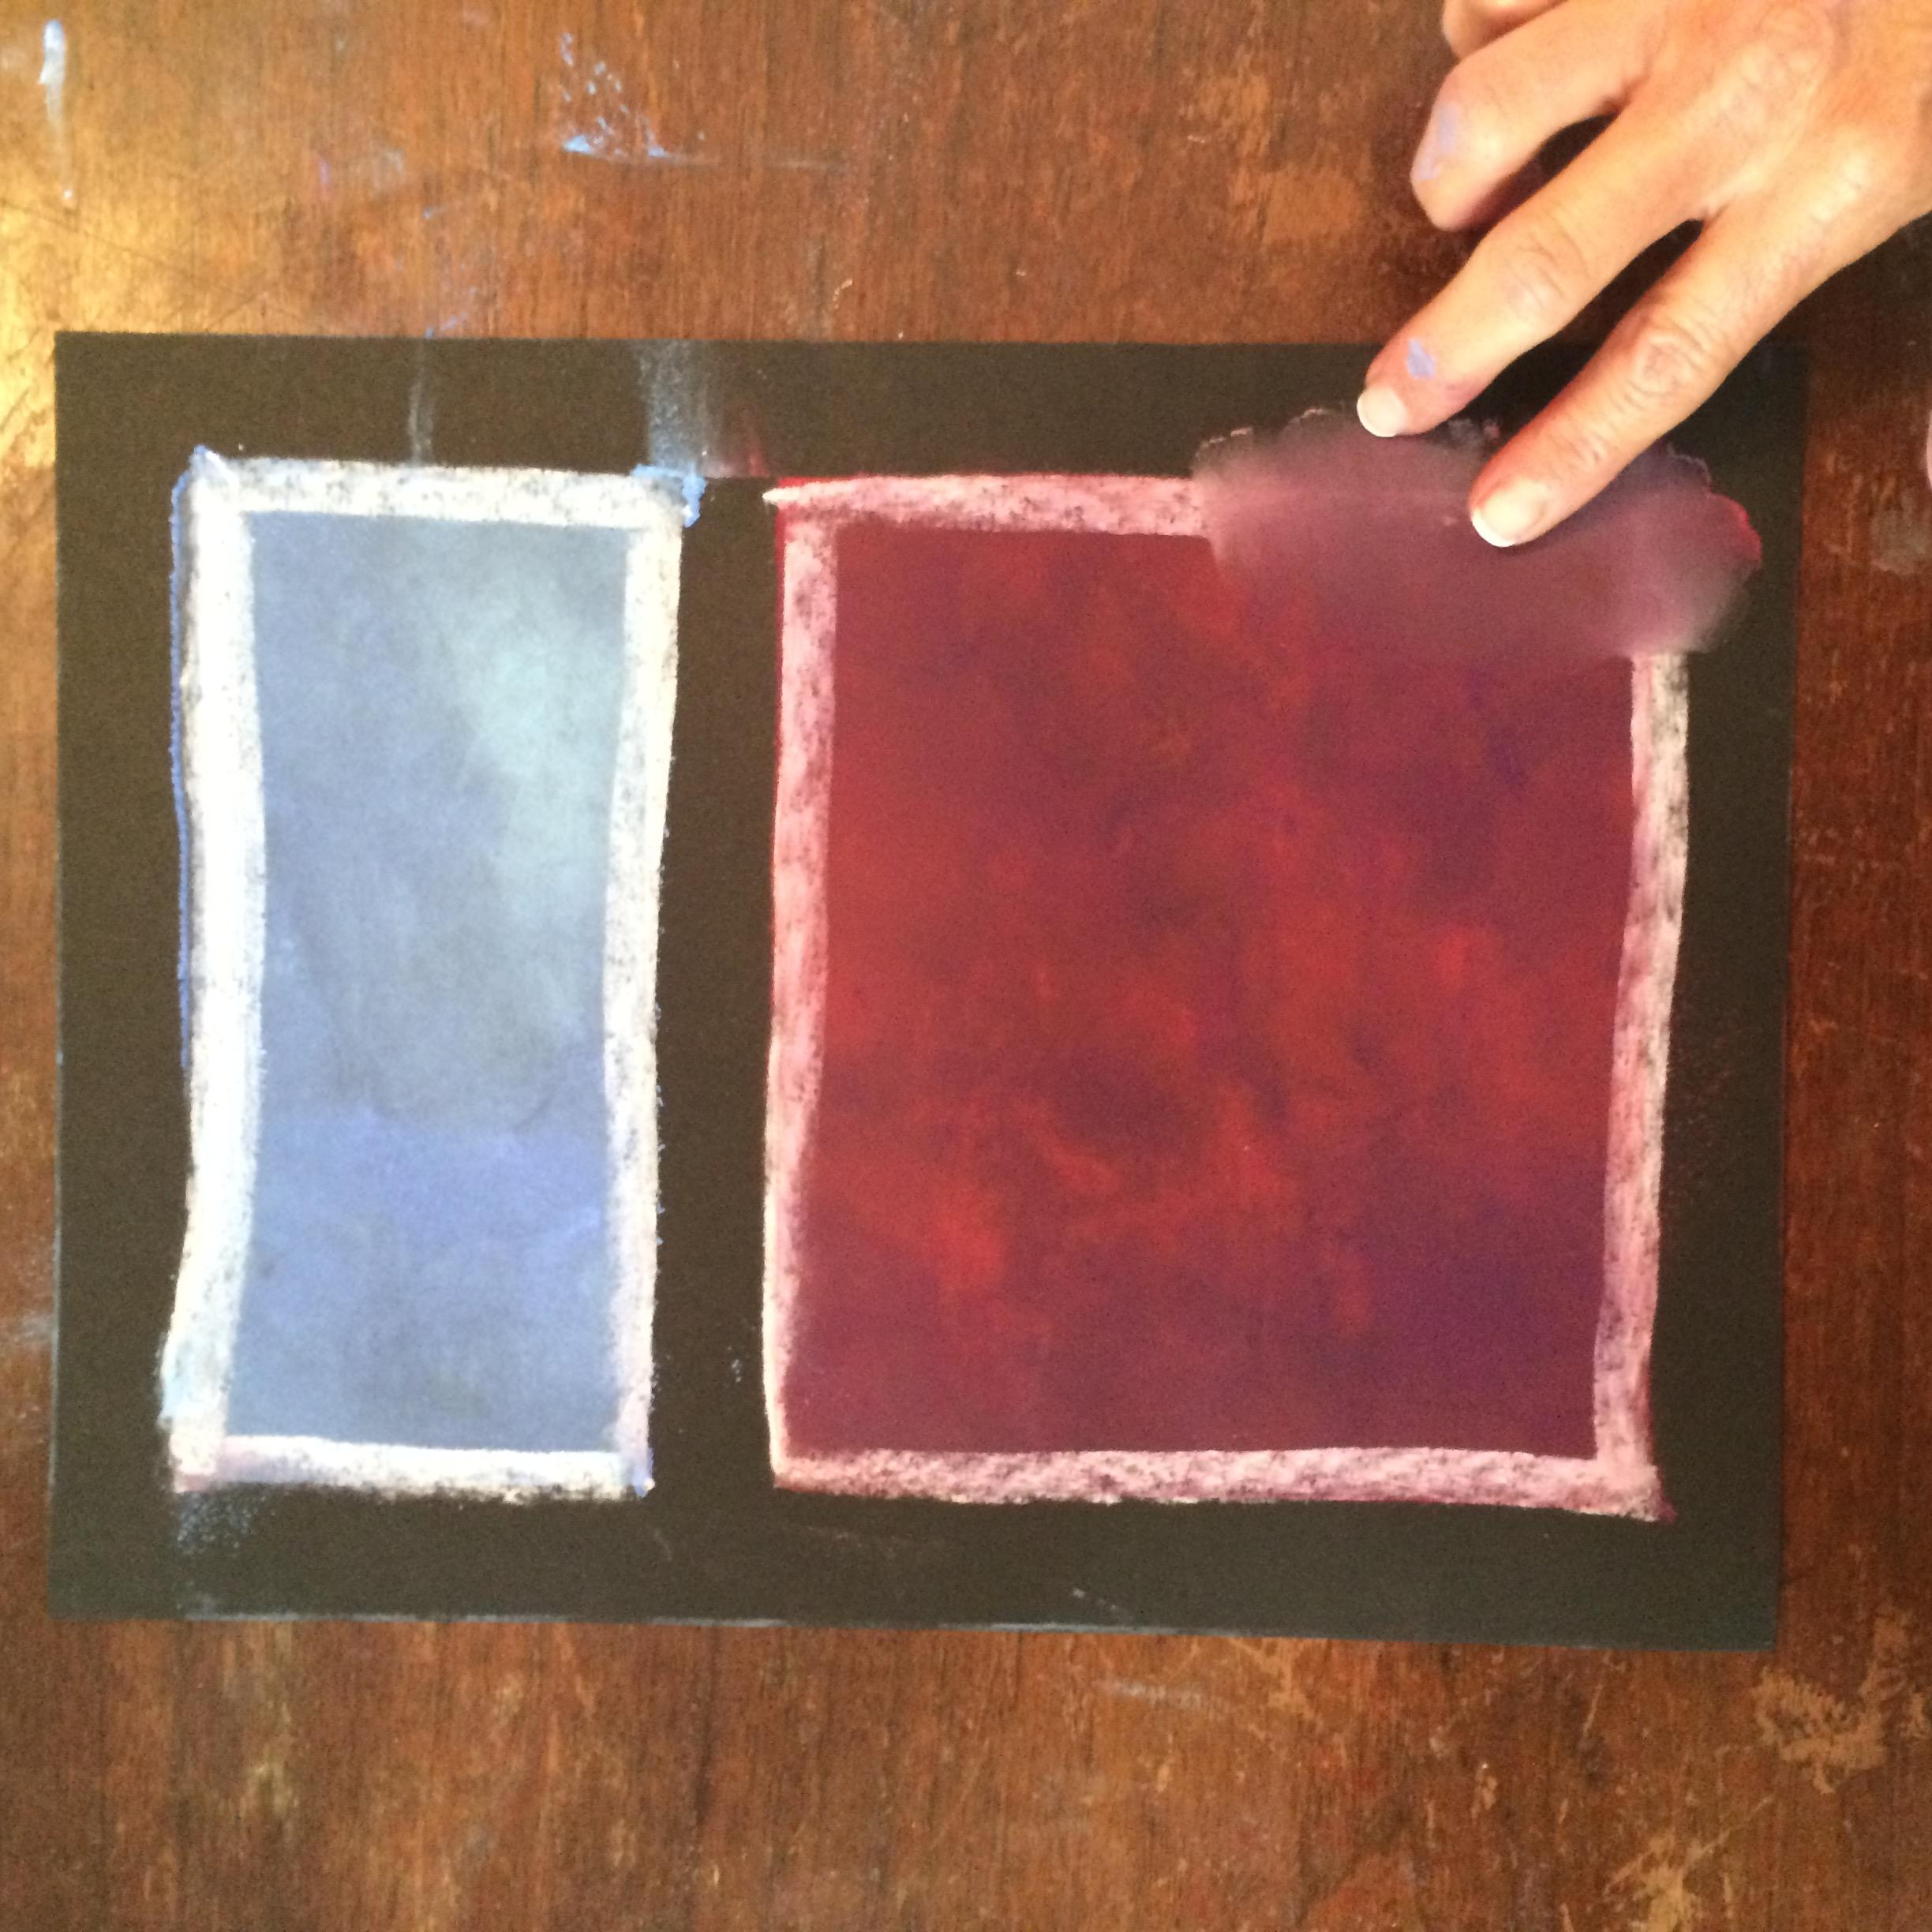
Add white chalk lines around each box and smudge in the direction of the color field. (in to the color box)
This will create feathery, fuzzy edges like Rothko did with paint and turpentine!

Slide 21
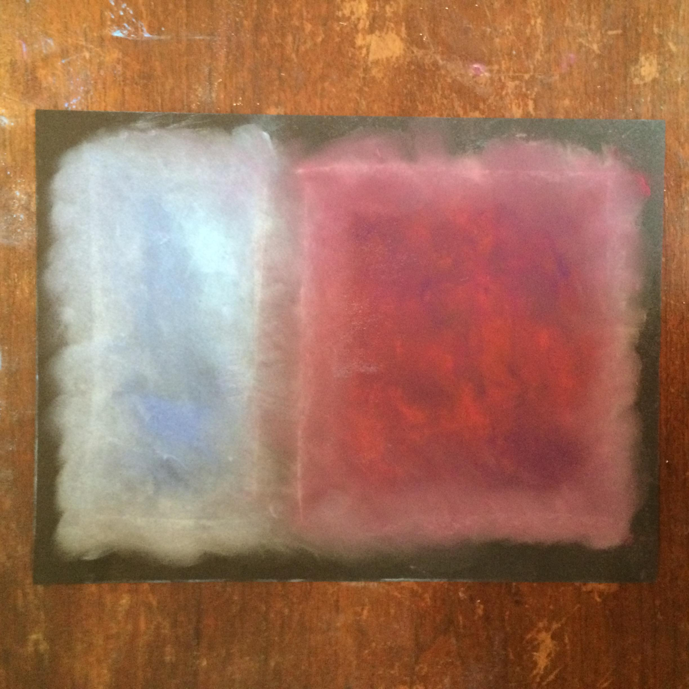

Slide 22
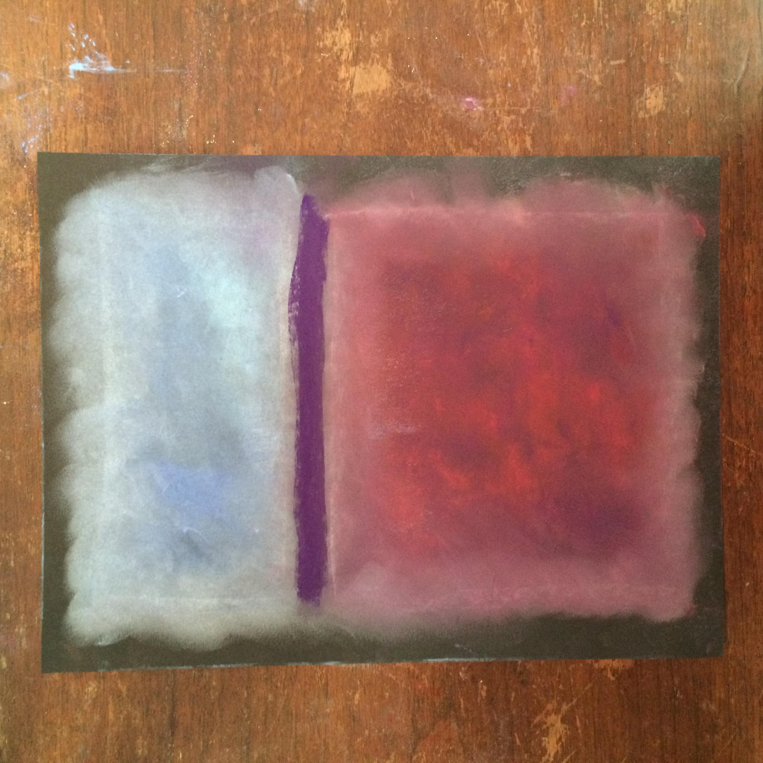
Separate the upper and lower rectangles by choosing a contrasting color to fill the middle blank space.
Color ONLY to the edge of the rectangles, NOT to the edge of the paper.

Slide 23
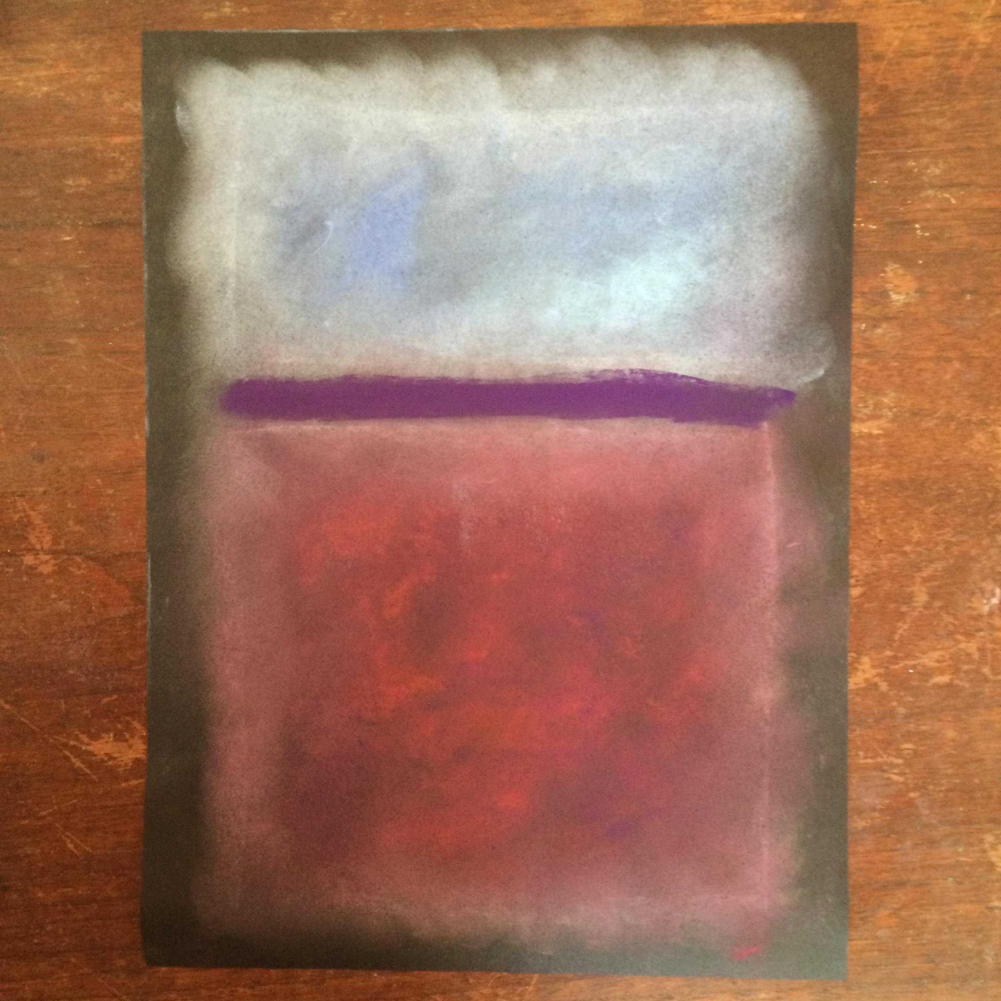
Smudge the center line and spray with hair spray/fixative (outside) to set the talk from transferring.

Slide 24
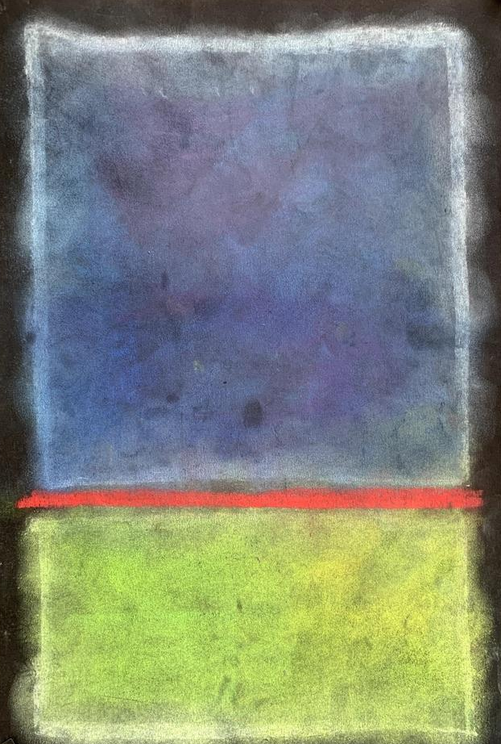
Congrats!
You made an authentic, one-of-a-kind piece of artwork!

