Slide 1


Palos Verdes Art Center

Slide 2
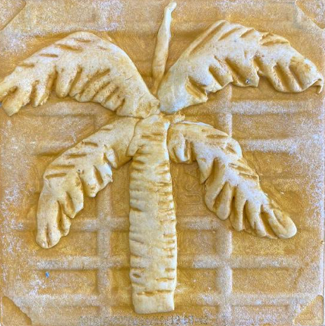
Bas Relief Sculpture
Hanging Gardens of Babylon
Created by Lee-Jean Lin

Slide 3
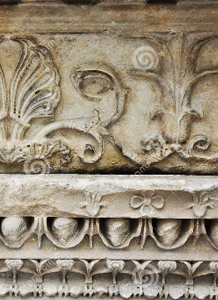
Motivation/Objectives
Learn about the history of bas-relief and the process involved
Create own version of a low-relief sculpture using modeling clay on tiles

Slide 4
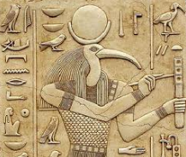
What is Bas-Relief?
Originally from the Italian basso-relievo (“low relief”)
Figures are just barely more prominent than the flat background
Front view only, distorted side view, e.g. coin
Various degrees of relief (high, mid, low, sunk)
Notes:
Relief is not specific to any one culture and the technique is as old as humankind's artistic explorations. “Relief” is a form of sculpture in which a solid piece of material is carved so that objects project from a background. There are different degrees of relief depending on the degree of projection of the sculpted form from the field.
High relief where more than 50% of the depth is shown and there may be undercut areas,
Mid-relief
Low relief or bas-relief, shallow-relief where the plane is only very slightly lower than the sculpted elements
Sunk relief that image is made by cutting the relief sculpture itself into a flat surface, mainly restricted to ancient Egypt such as hieroglyph on the tomb walls.

Slide 5
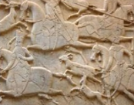
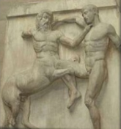
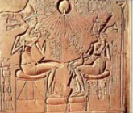
Relief Sculpture Style
Notes:
There are different styles of relief depending on the degree of projection of the sculpted form from the field. The full range includes high, mid or low relief (bas-relief), and hollow (sunken) relief.

Slide 6
Hanging Garden
One of the seven wonders of the ancient world
Original word “Kremastos” means “overhanging”, such as Terrace or Balcony
Nebuchadrezarr II built for Queen Amytis
Near Royal palace of Babylon, now Iraq. (Location has not been established)
No existing Babylonian text or archeological evidence has been found
  Mythical?
  Built but Destroyed?
  Mixed up with Hanging Garden in Assyrian Capital?
Notes:
This ancient garden is considered one of the Seven Wonders of the World which was located near the royal palace in Babylon, now in modern day southern Iraq. It’s the work of King Nebuchadrezzar II (reigned c. 605–c. 561 BCE), who built them to console his Median wife, Amytis, because she missed the mountains and greenery of her homeland. The Hanging Gardens probably did not really “hang” in the sense of being suspended from cables or ropes. The name comes from a translation of Greek word “kremastos”, which means not just “hanging” but “overhanging” as in the case of terrace or balcony.
It’s the only one of the Seven Wonders for which the location has not been definitively established. There are no Babylonian texts that mention the gardens, and no definitive archaeological evidence has been found in Babylon. Three theories have been suggested to account for this:
They were purely mythical, and the descriptions found in ancient Greek and Roman writings represented a romantic ideal of an eastern garden;
They existed in Babylon, but were destroyed sometime around the first century A
The legend refers to a well-documented garden that the Assyrian King Sennacherib (704–681 BC) built in his capital city of Nineveh on the River Tigris, near the modern city of Mosul.
Several

Slide 7
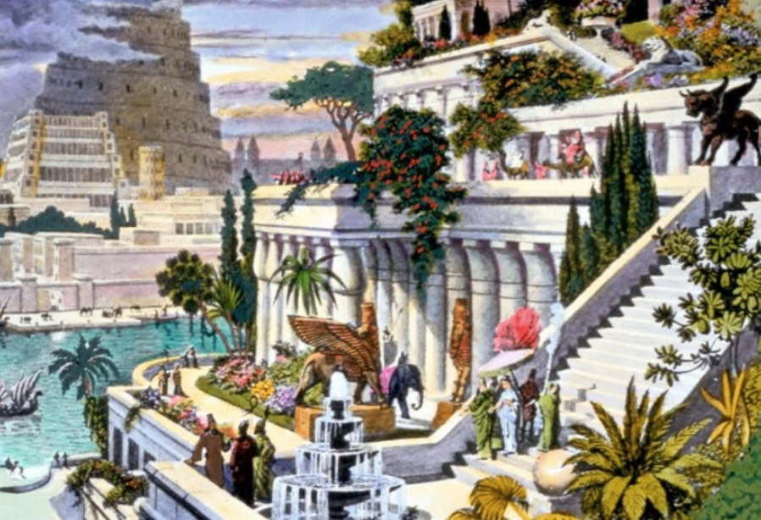
Notes:
This hand-colored engraving, probably made in the 19th century after the first excavations in the Assyrian capitals, depicts the fabled Hanging Gardens, with the Tower of Babel in the background. It was built by King Sennacherib. According to the tradition, the gardens did not hang, but grew on the roofs and terraces of the royal palace in Babylon

Slide 8
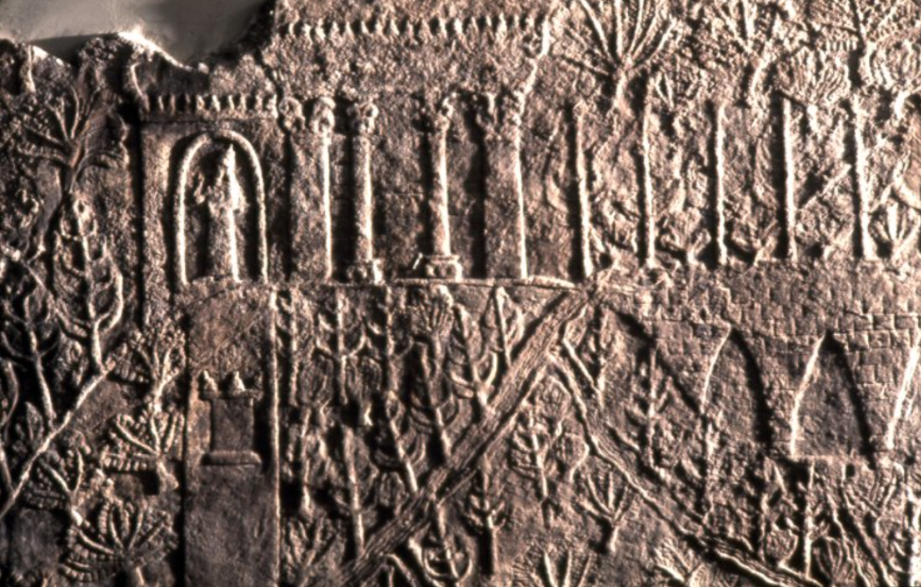
Assyrian wall relief showing gardens in Nineveh
Notes:
King Sennacherib's garden was well-known not just for its beauty – a year-round oasis of lush green in a dusty summer landscape – but also for the marvelous feats of water engineering that maintained the garden. This bas relief from the North Palace of Ashurbanipal (669–631 BC) at Nineveh shows a luxurious garden watered by an aqueduct.

Slide 9
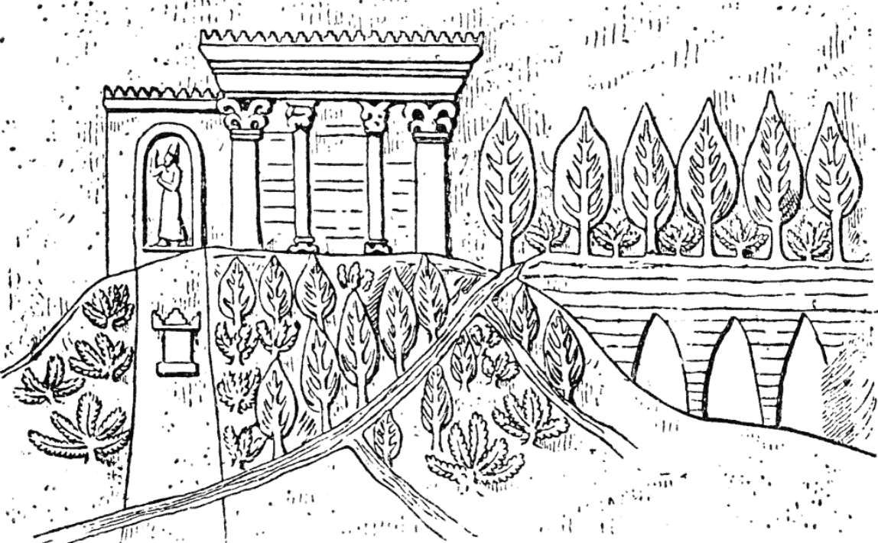
Notes:
The irrigation of such a garden demanded an upgraded water supply to the city of Nineveh. The canals stretched over 50 km (31 mi) into the mountains. Sennacherib was proud of the technologies he had employed and describes them in some detail on his inscriptions.
Fruit tree orchards were planted. Also mentioned were pines, cypresses and junipers; almond trees, date trees, ebony, rosewood, olive, oak, tamarisk, walnut, terebinth, ash, fir, pomegranate, pear, quince, fig, and grapes

Slide 10
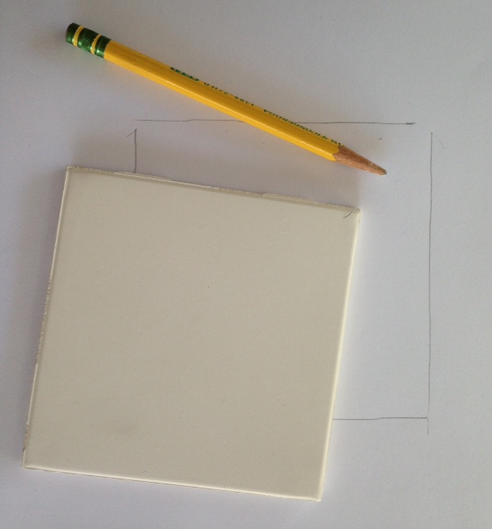
Procedure
Trace the tile on the wax paper with a pencil

Slide 11
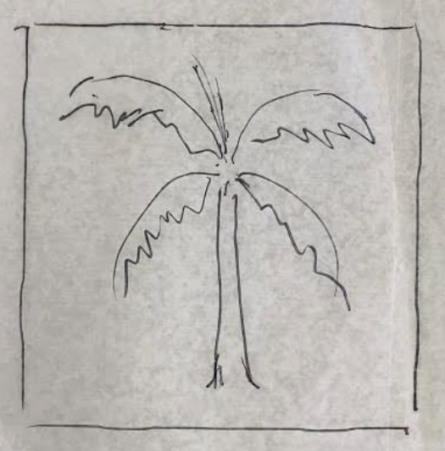
Procedure
Draw your design (inside the square) on the wax paper

Slide 12
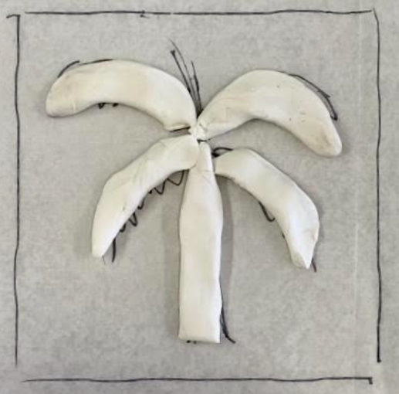
Procedure
Mold your clay on the paper (no texture)
If your design is directional, mold the clay on the back side of the (to create a mirror image of your design)

Slide 13
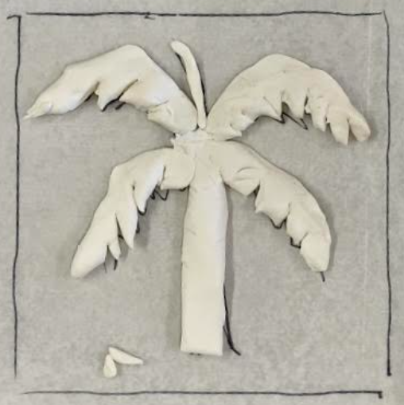
Procedure
Trim the edges of the clay if necessary
Place a few dots of white glue on the clay

Slide 14
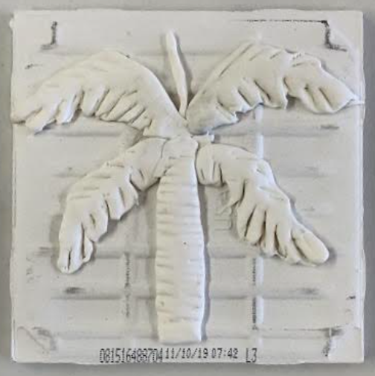
Procedure
Flip the wax paper and clay on the tile
Add details and texture

Slide 15
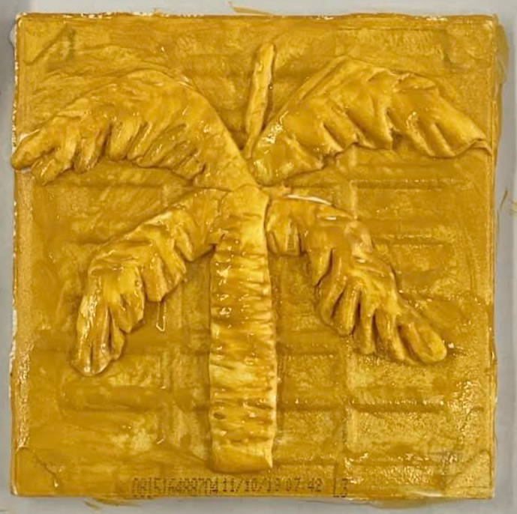
Procedure
Paint the tile, including four side edges

Slide 16
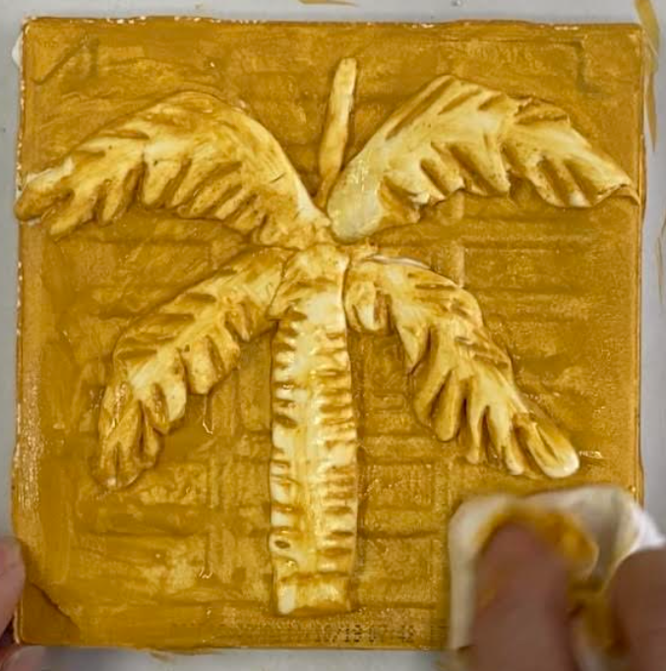
Procedure
Wipe off paint on the clay with wet towel to high light the design.

Slide 17
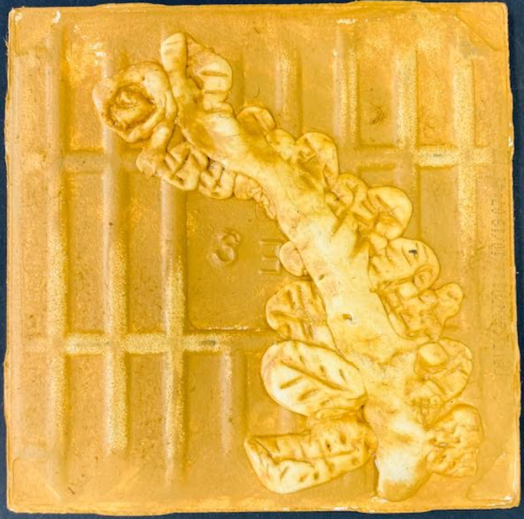
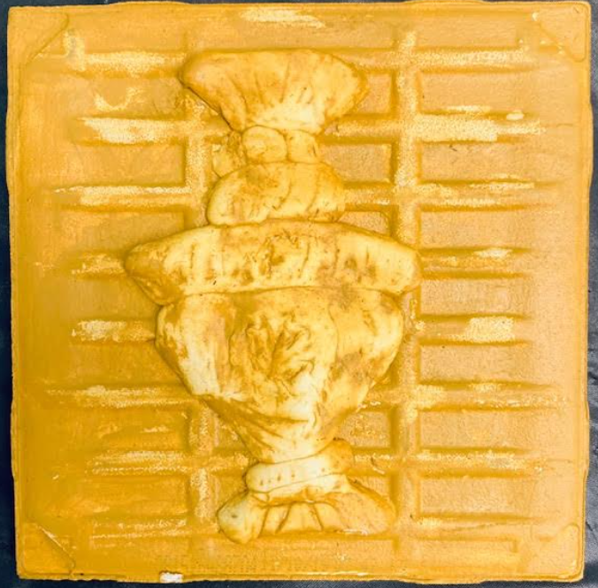
Finished Tiles

Slide 18
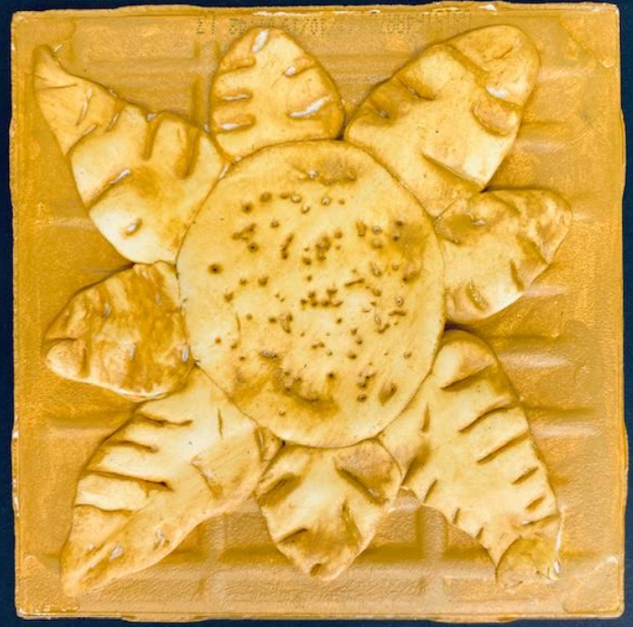
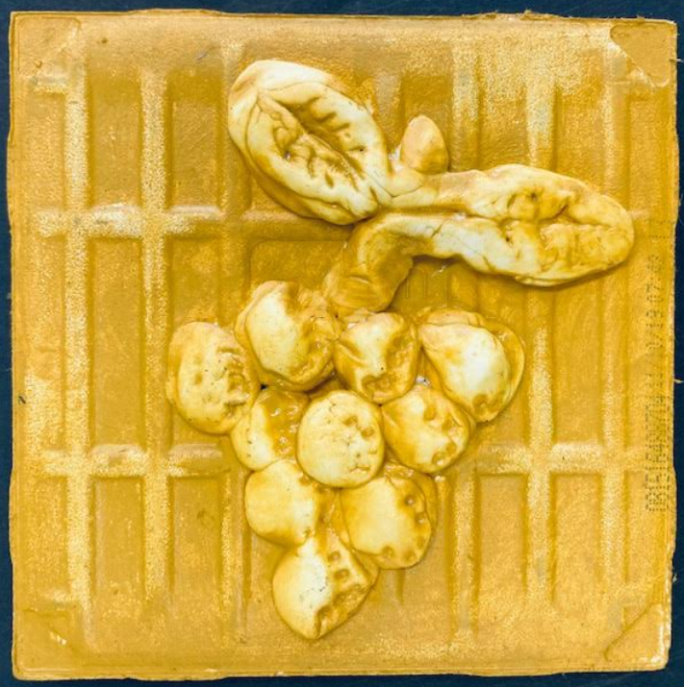
Finished Tiles

Slide 19
Reflection….
What is Bas Relief?
Where is Babylon?
What does a Hanging Garden look like?
What clay techniques did you use in this project?
Are you happy with your project? What do you like best about your project? What might you change if you do it again?

